Slide 1
Client side Features
Config Client features (for Spring applications):
Bind to the Config Server and initialize Spring Environment with remote property sources
Encrypt and decrypt property values (symmetric or asymmetric)

Slide 2
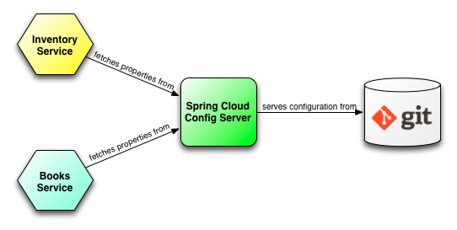
Spring Cloud Config Server

Slide 3
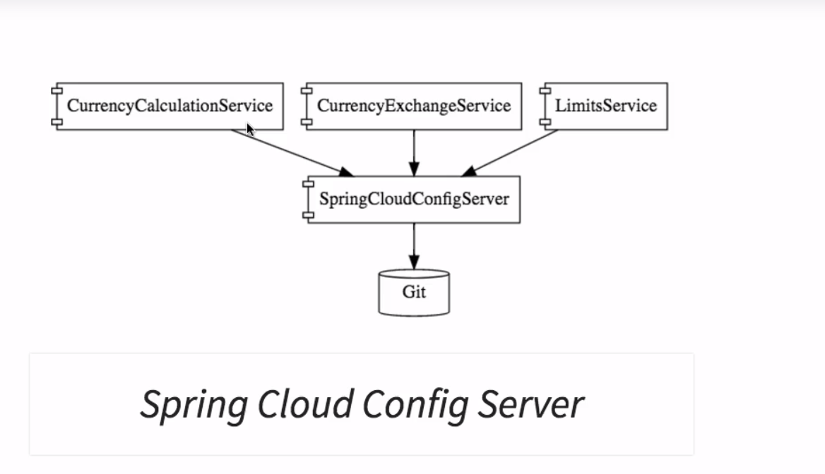
Spring Cloud

Slide 4
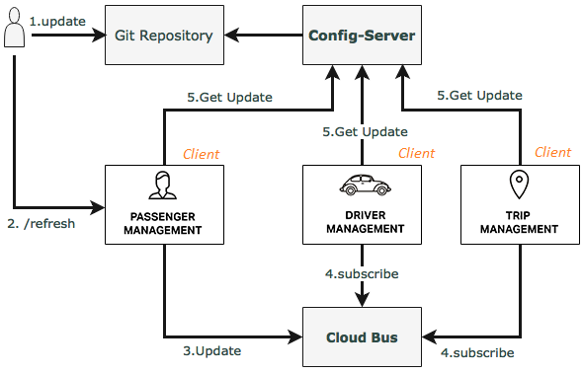
Spring Cloud Bus

Slide 5
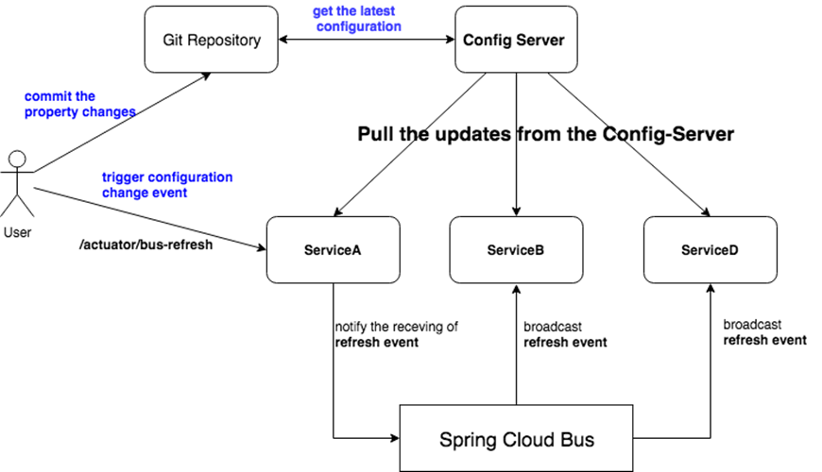
Spring Cloud Bus

Slide 6
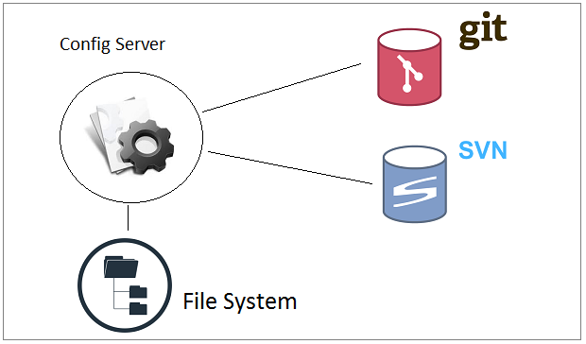
How does Config Server Store Data

Slide 7
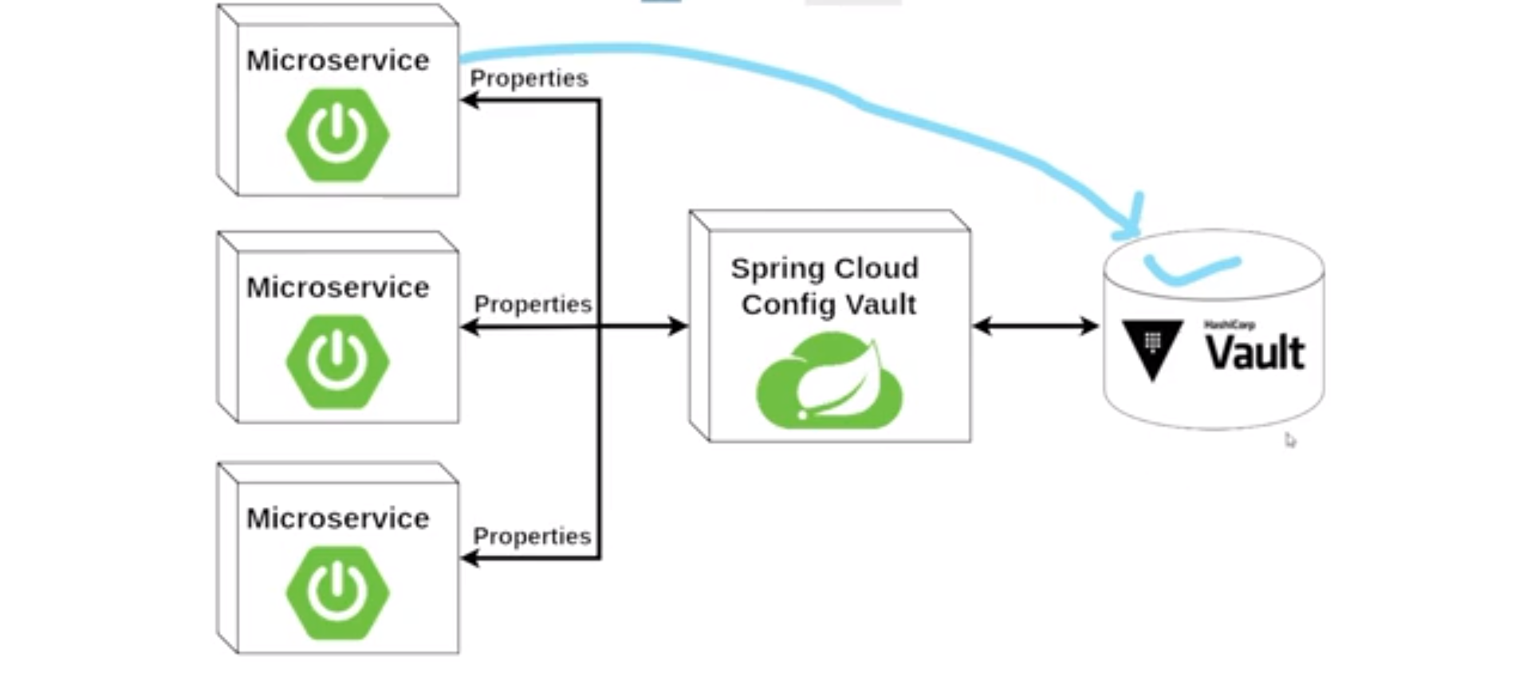
Vault

Slide 8
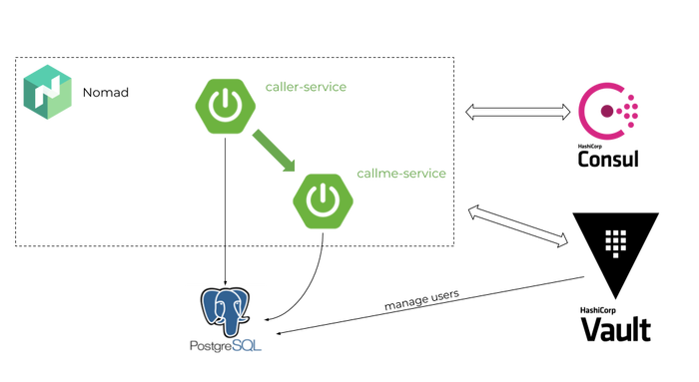
Vault

Slide 9
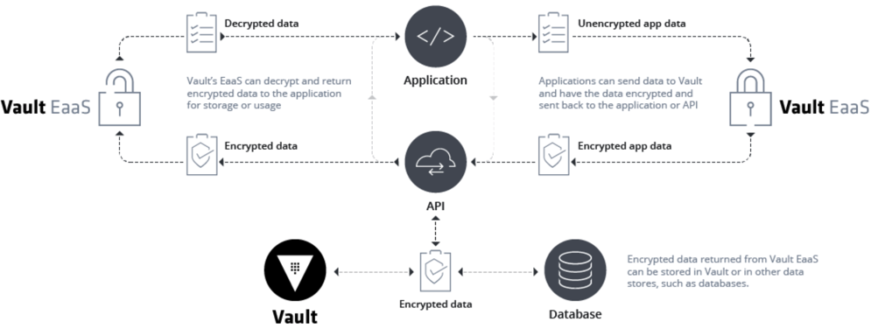
Vault

Slide 10
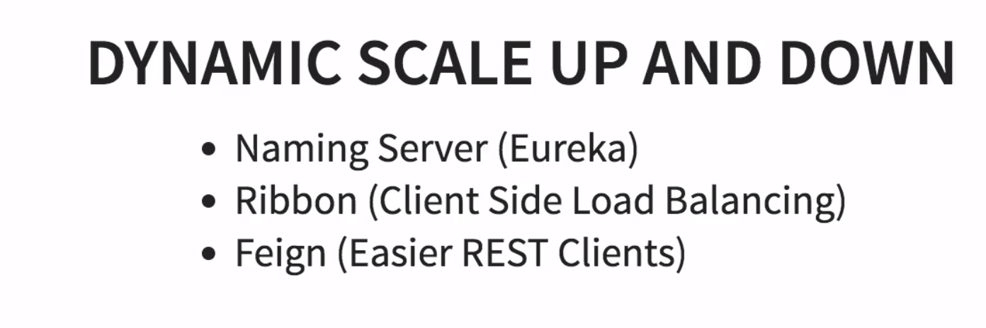
Spring Cloud

Slide 11
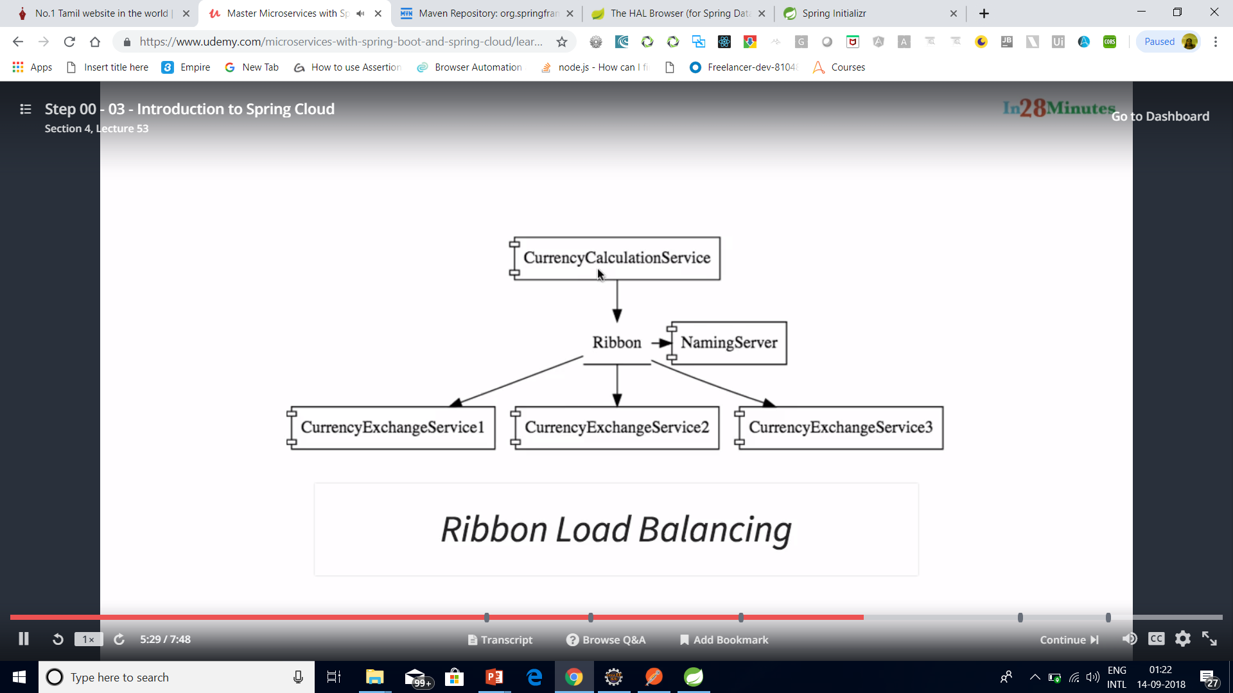
Spring Cloud

Slide 12
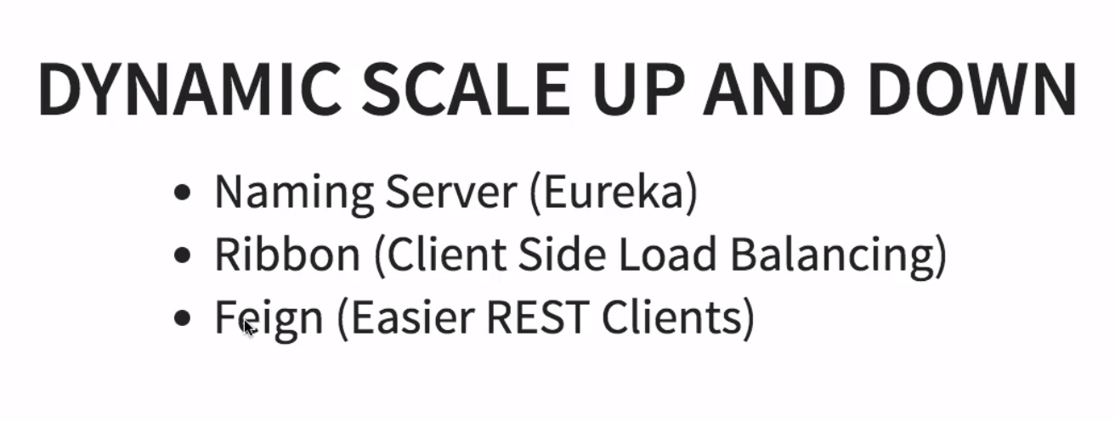
Spring Cloud

Slide 13
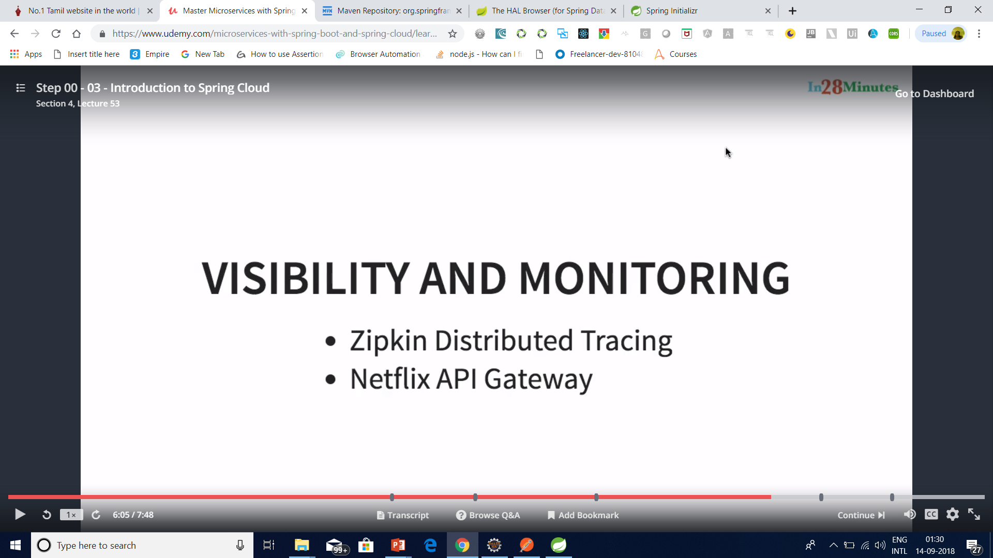
Spring Cloud

Slide 14
Important Spring Cloud Modules
Dynamic Scale Up and Down. Using a combination of
Naming Server (Eureka)
Ribbon (Client Side Load Balancing)
Feign (Easier REST Clients)
Visibility and Monitoring with
Zipkin Distributed Tracing
Netflix API Gateway
Configuration Management with
Spring Cloud Config Server
Fault Tolerance with
Hystrix

Slide 15
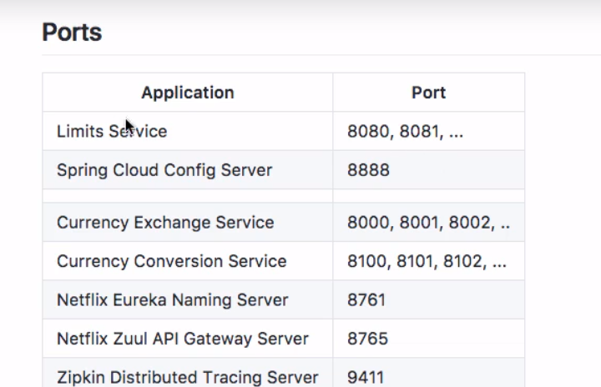
Standardized ports

Slide 16
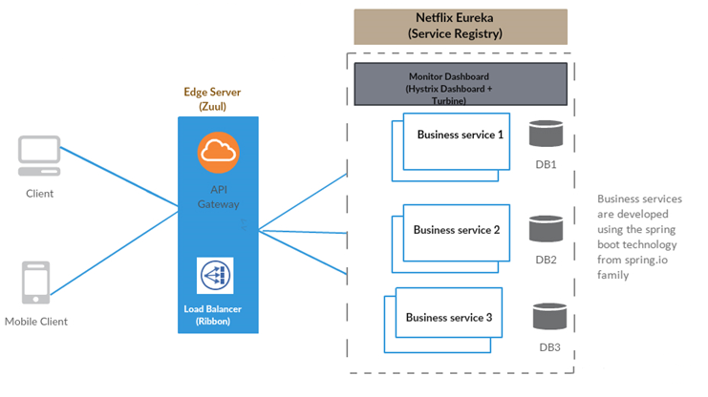

Slide 17
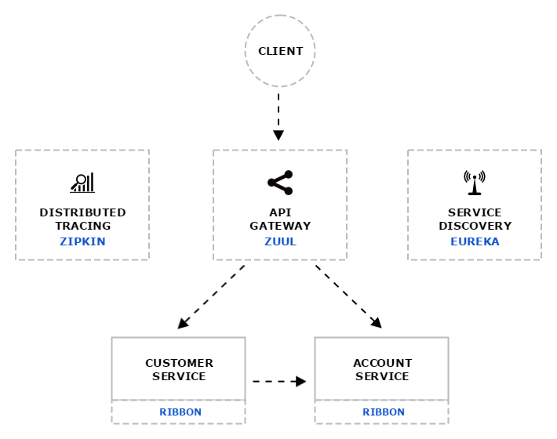
Distributed tracing system with request visualization.
Monitoring, routing and security
client side Load Balancers

Slide 18
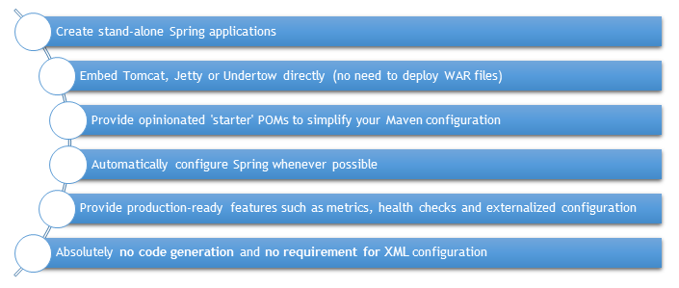
Spring Boot and Microservices

Slide 19
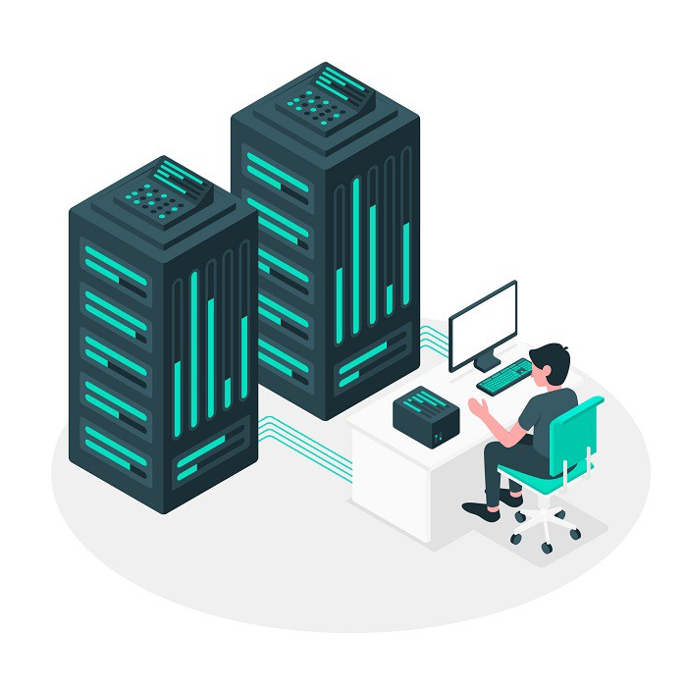
Spring Cloud High Availability

Slide 20
Why Eureka Server
In the distributed computing are there is a concept called ‘Service registration and discovery’ where one dedicated server is responsible to maintain the registry of all the Microservice that has been deployed and removed. This will act like a phone book of all other applications/microservices.

Slide 21
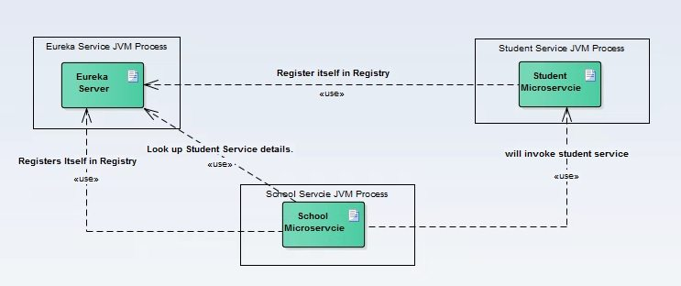
Spring Cloud Service Discovery with Netflix Eureka

Slide 22
Server Configuration
server:
port: ${PORT:8761} # Indicate the default PORT where this service will be started
eureka:
client:
registerWithEureka: false #telling the server not to register himself in the service registry
fetchRegistry: false
server:
waitTimeInMsWhenSyncEmpty: 0 #wait time for subsequent sync

Slide 23
Server Configuration
Name | Description
spring.application.name | Unique name for a Eureka server service.
eureka.client.serviceUrl.defaultZone | It consults with other Eureka servers to sync the service registry. As it is in standalone mode, I am giving the local server address.
server.port | In which port the server will be bound.
eureka.client.register-with-eureka | This determines if this server registers itself as a client; as I said earlier, the Eureka server is also acting as a client so that it can sync the registry. The value being false means it prevents itself from acting as a client.
eureka.client.fetch-registry | Does not register itself in the service registry.

Slide 24
Client Configuration
server:
port: 8098 #default port where the service will be started
eureka: #tells about the Eureka server details and its refresh time
instance:
leaseRenewalIntervalInSeconds: 1
leaseExpirationDurationInSeconds: 2
client:

Slide 25
Client Configuration
serviceUrl:
defaultZone: http://127.0.0.1:8761/eureka/
healthcheck:
enabled: true
lease:
duration: 5
spring:
application:
name: student-service #current service name to be used by the eureka server

Slide 26
Client Configuration
management:
security:
enabled: false #disable the spring security on the management endpoints like /env, /refresh etc.
logging:
level:
com.example.howtodoinjava: DEBUG

Slide 27
Client Configuration
If registerWithEureka is true, an instance registers with a Eureka server using a given URL; then onwards, it sends heartbeats every 30s (configurable by eureka.instance.leaseRenewalIntervalInSeconds).
If the server doesn’t receive a heartbeat, it waits 90s (configurable by eureka.instance.leaseExpirationDurationInSeconds) before removing the instance from registry and there by disallowing traffic to that instance.
Sending heartbeat is an asynchronous task;
if the operation fails, it backs off exponentially by a factor of 2 until a maximum delay of eureka.instance.leaseRenewalIntervalInSeconds * eureka.client.heartbeatExecutorExponentialBackOffBound is reached.
There is no limit to the number of retries for registering with Eureka.

Slide 28
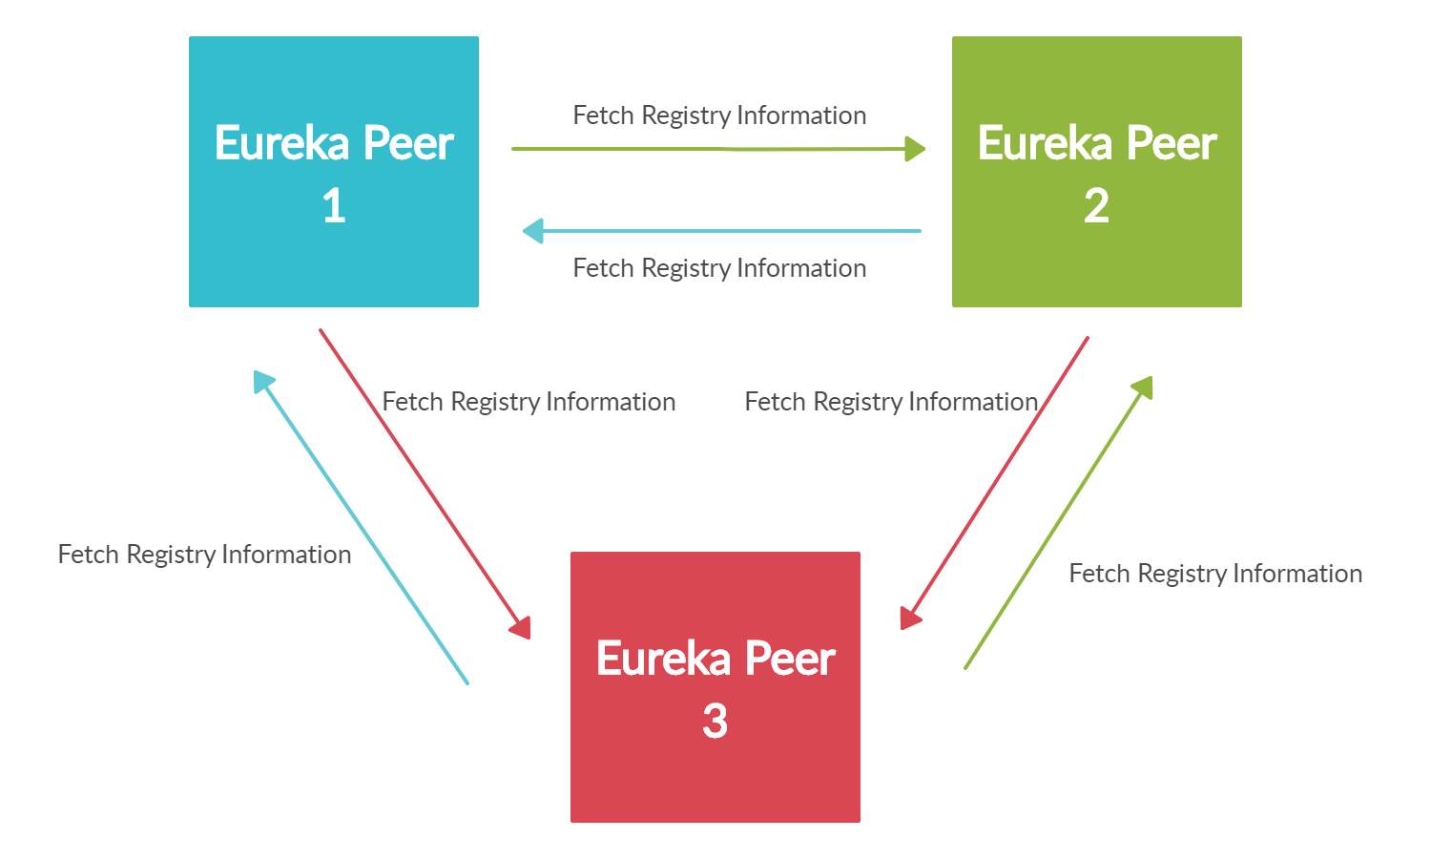
Eureka Cluster

Slide 29
Eureka Cluster
Step 1 — Edit the hosts file (Windows): You have to first edit the C:\Windows\System32\drivers\etc\hosts file
127.0.0.1 peer-1-server.com 127.0.0.1 peer-2-server.com 127.0.0.1 peer-3-server.com
Step 2 — Build the Eureka server
Step 3 — Start the Eureka Server

Slide 30
Eureka Cluster
java -jar -Dspring.profiles.active=peer-1 eureka-server-1.0.0-SNAPSHOT.jar
java -jar -Dspring.profiles.active=peer-2 eureka-server-1.0.0-SNAPSHOT.jar
java -jar -Dspring.profiles.active=peer-3 eureka-server-1.0.0-SNAPSHOT.jar

Slide 31
Eureka Cluster
Step 4: Validating server startup
http://peer-1-server.com:9001/ http://peer-2-server.com:9002/ http://peer-3-server.com:9003/

Slide 32
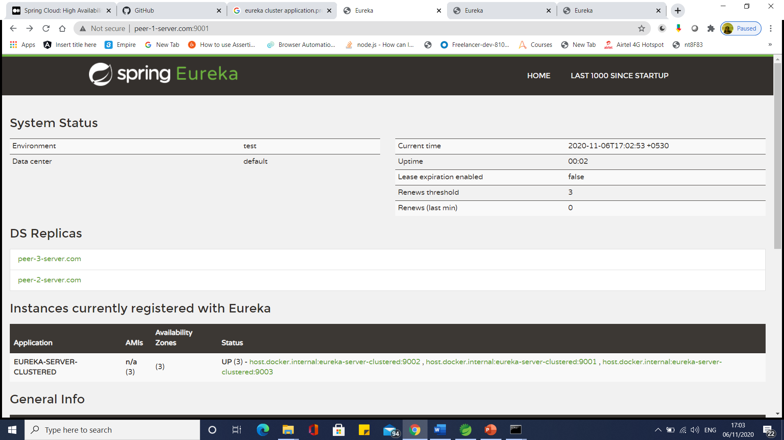

Slide 33


Slide 34
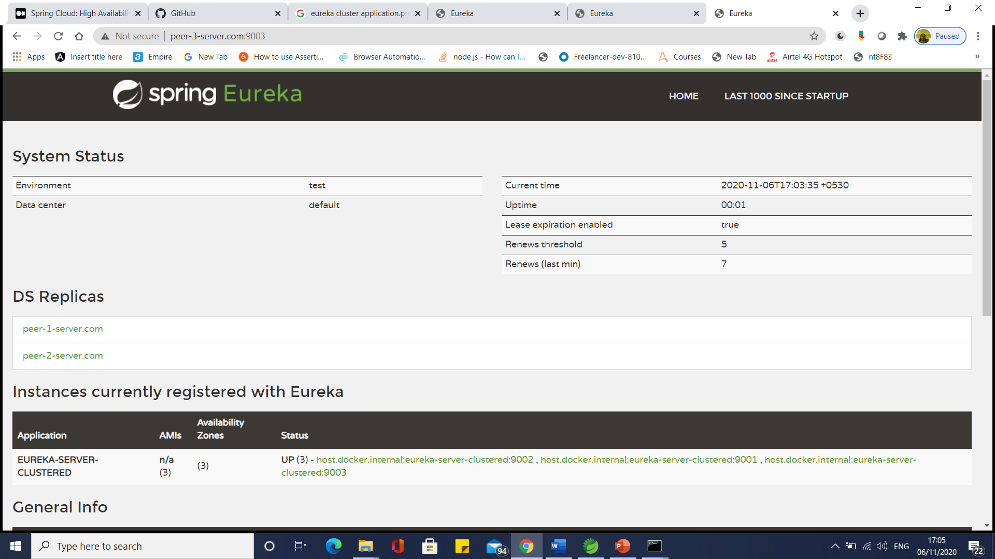

Slide 35
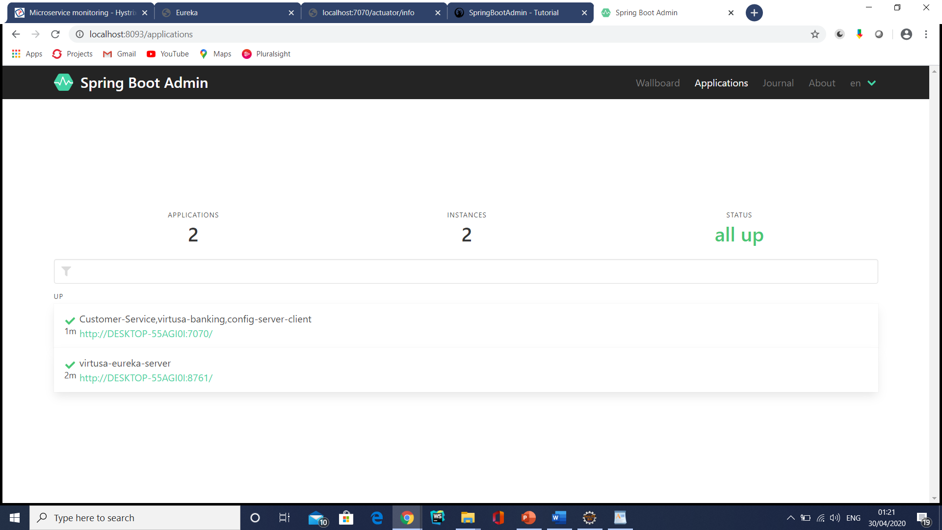
Eureka Admin Server

Slide 36
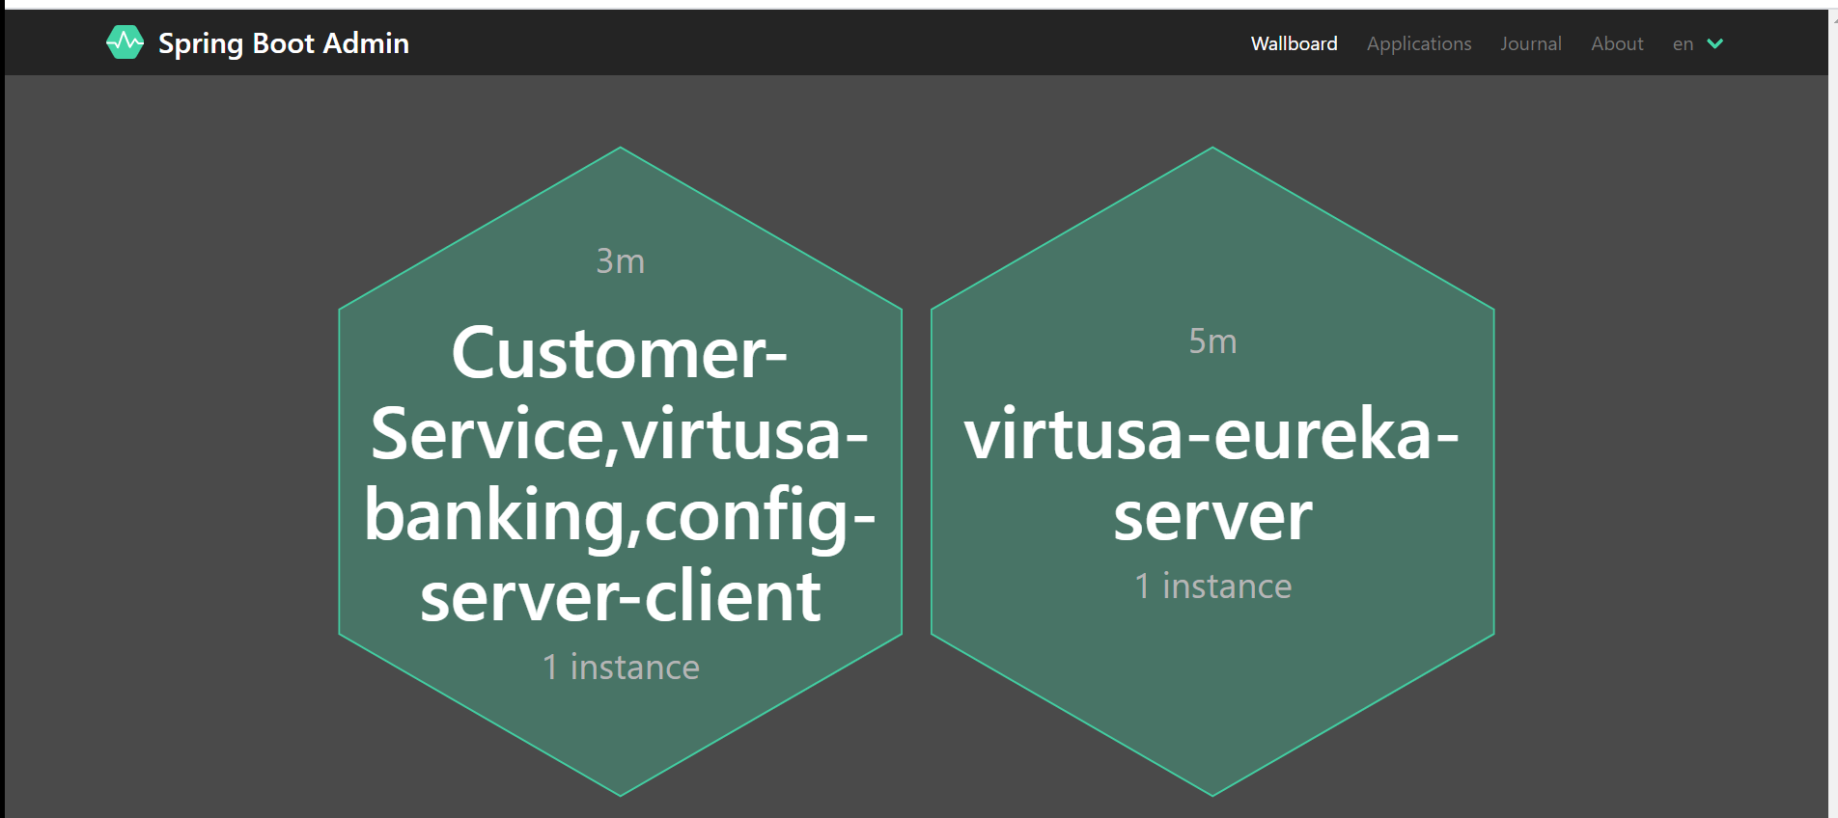
Eureka Admin Server

Slide 37
Consul Service Registration and Discovery Example
Consul provides multiple features like service discovery, configuration management, health checking and key-value store etc.

Slide 38
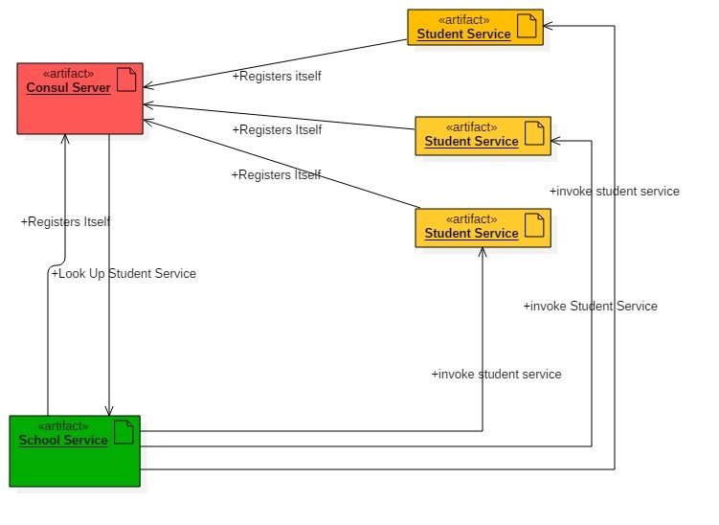
Consul Service Registration and Discovery Example
Consul Agent – running on localhost acting as discovery/registry server functionality.

Slide 39
Configuring Consul in Local workstation
Download from Consul portal. Choose particular package based on the operating System. Once downloaded the zip, we need to unzip it to desired place.
Start Consul Agent in local workstation – The Zip file that we have unzipped, has only one exe file called consul.exe. We will start a command prompt here and use below command to start the agent.
consul agent -server -bootstrap-expect=1 -data-dir=consul-data -ui -bind=192.168.99.1

Slide 40
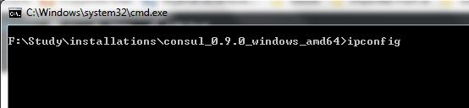
Configuring Consul in Local workstation
Make sure you enter the correct bind address, it would be different depending on the LAN settings. Do a ipconfig in command prompt to know your IpV4 address and use it here.

Slide 41
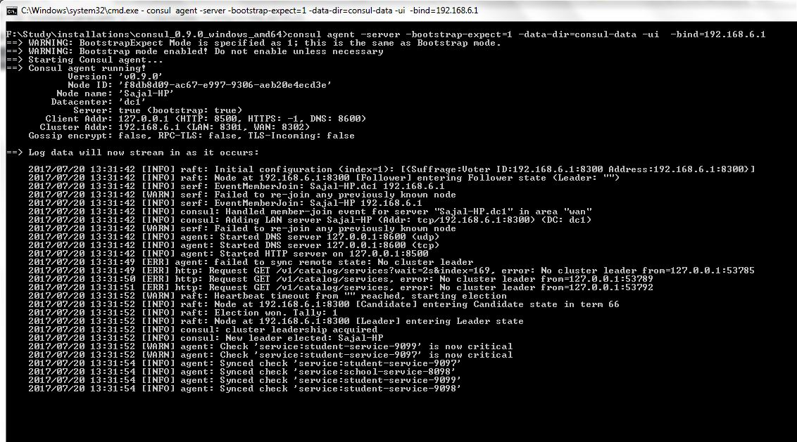
Configuring Consul in Local workstation

Slide 42
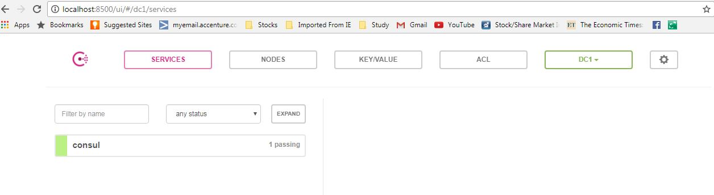
Configuring Consul in Local workstation
Test whether Consul Server is running – Consul runs on default port and once agent started successfully, browse http://localhost:8500/uiand you should see a console screen like –

Slide 43
Consul Client
Create Student Project
Create a Spring boot project from initializer portal with four dependencies i.e.
Actuator
Web
Rest Repositories
Consul Discovery

Slide 44
Service Configuration
server.port=9098 – will start the service in default 9098 port.
spring.application.name: student-service – will registers itself in consul server using student-service tag and also other services will lookup this service with this name itself.
management.security.enabled=false – is not actually required for this exercise, but it will disable spring security in the management endpoints provided by actuator module.

Slide 45
Hystrix Circuit Breaker Pattern – Spring Cloud
It is generally required to enable fault tolerance in the application where some underlying service is down/throwing error permanently, we need to fall back to different path of program execution automatically.
This is related to distributed computing style of Eco system using lots of underlying Microservices.
This is where circuit breaker pattern helps and Hystrix is an tool to build this circuit breaker.

Slide 46
What is Circuit Breaker Pattern?
If we design our systems on microservice based architecture, we will generally develop many Microservices and those will interact with each other heavily in achieving certain business goals.
Now, all of us can assume that this will give expected result if all the services are up and running and response time of each service is satisfactory.

Slide 47
What is Circuit Breaker Pattern?
Now what will happen if any service, of the current Eco system, has some issue and stopped servicing the requests.
It will result in timeouts/exception and the whole Eco system will get unstable due to this single point of failure.

Slide 48
What is Circuit Breaker Pattern?
Here circuit breaker pattern comes handy and it redirects traffic to a fall back path once it sees any such scenario.
Also it monitors the defective service closely and restore the traffic once the service came back to normalcy.

Slide 49
What is Circuit Breaker Pattern?
So circuit breaker is a kind of a wrapper of the method which is doing the service call and it monitors the service health and once it gets some issue, the circuit breaker trips and all further calls goto the circuit breaker fall back and finally restores automatically once the service came back !! That’s cool right?

Slide 50
Circuit Breaker
The Circuit Breaker pattern functions in a similar fashion to an electrical Circuit Breaker:
When a number of consecutive failures cross the defined threshold, the Circuit Breaker trips.
For the duration of the timeout period all requests invoking the remote service will fail immediately.
After the timeout expires the Circuit Breaker allows a limited number of test requests to pass through.
If those requests succeed the Circuit Breaker resumes normal operation.
Otherwise, if there is a failure the timeout period begins again.

Slide 51
Circuit Breaker States
The circuit breaker has 3 distinct states, Closed, Open, and Half-Open.
Closed – When everything is normal, the circuit breaker remains in the closed state and all calls pass through to the services.
When the number of failures exceeds a predetermined threshold the breaker trips, and it goes into the Open state.

Slide 52
Circuit Breaker States
Open – The circuit breaker returns an error for calls without executing the function.
Half-Open – After a timeout period, the circuit switches to a half-open state to test if the underlying problem still exists.
If a single call fails in this half-open state, the breaker is once again tripped. If it succeeds, the circuit breaker resets back to the normal closed state

Slide 53
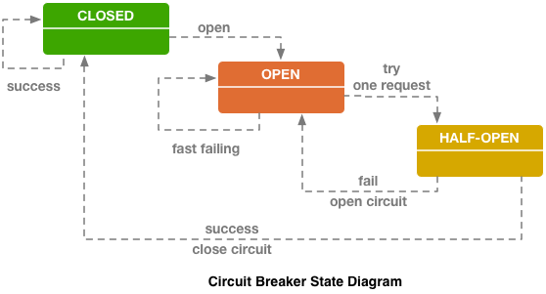
Circuit Breaker States

Slide 54
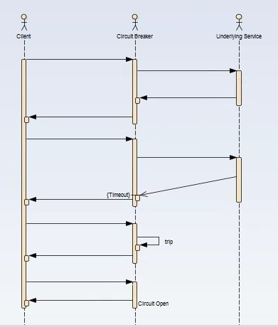
What is Circuit Breaker Pattern?

Slide 55
Hystrix Dashboard
http://localhost:9091/hystrix
http://localhost:9091/actuator/hystrix.stream – It’s a continuous stream that Hystrix generates. It is just a health check result along with all the service calls that are being monitored by Hystrix. Sample output will look like in browser –

Slide 56
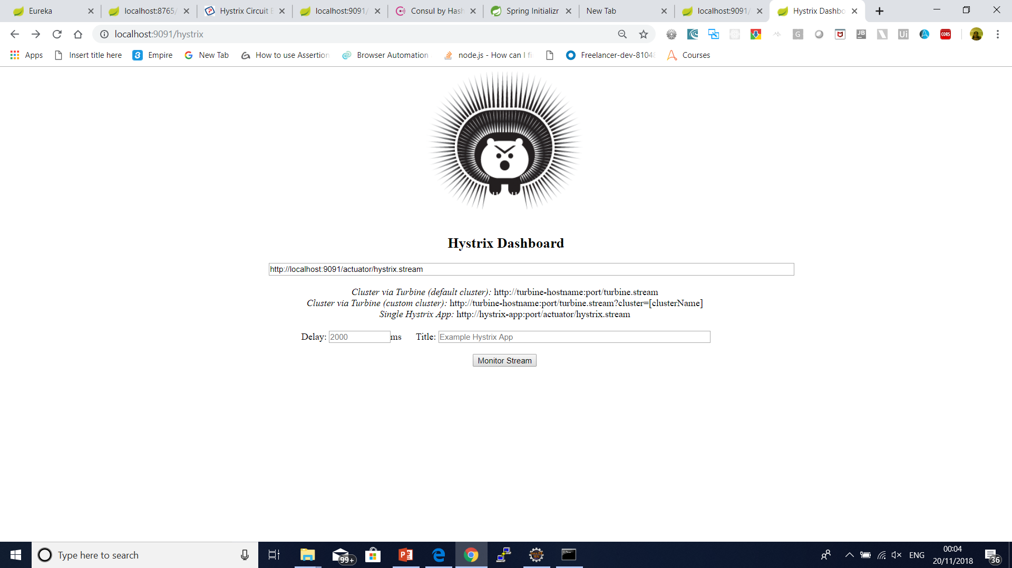

Slide 57
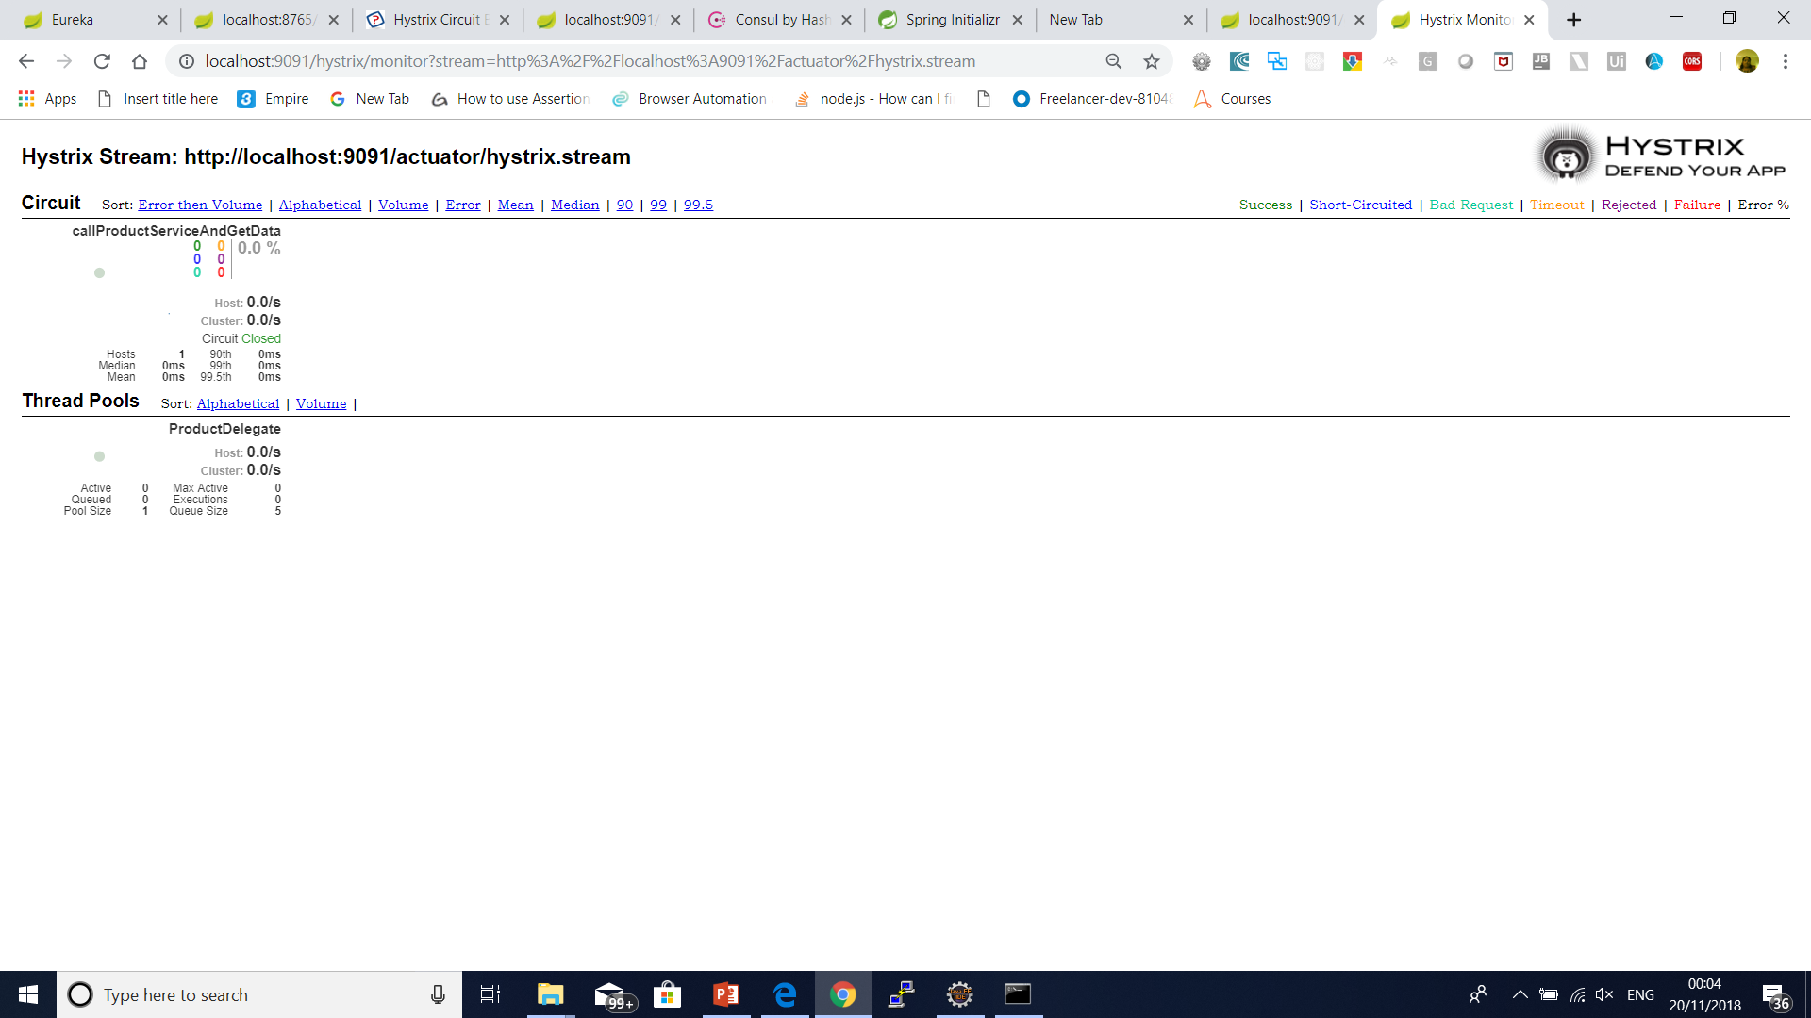

Slide 58
Name | Description | Triggers Fallback?
EMIT | value delivered (HystrixObservableCommand only) | NO
SUCCESS | execution complete with no errors | NO
FAILURE | execution threw an Exception | YES
TIMEOUT | execution started, but did not complete in the allowed time | YES
BAD_REQUEST | execution threw a HystrixBadRequestException | NO
SHORT_CIRCUITED | circuit breaker OPEN, execution not attempted | YES
THREAD_POOL_REJECTED | thread pool at capacity, execution not attempted | YES
SEMAPHORE_REJECTED | semaphore at capacity, execution not attempted | YES

Slide 59
Name | Description | Throws Exception?
FALLBACK_EMIT | fallback value delivered (HystrixObservableCommand only) | NO
FALLBACK_SUCCESS | fallback execution complete with no errors | NO
FALLBACK_FAILURE | fallback execution threw an error | YES
FALLBACK_REJECTION | fallback semaphore at capacity, fallback not attempted | YES
FALLBACK_MISSING | no fallback implemented | YES

Slide 60
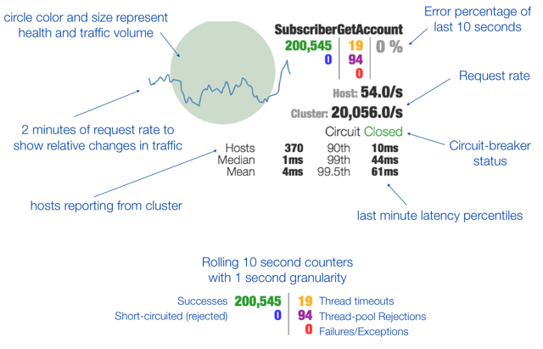

Slide 61
Circuit Breaker
@HystricCommand(fallbackMethod=”defaultProductList”, commandProperties = { @HystrixProperty(name=”execution.isolation.thread.timeoutInMilliSeconds”, value=”500”)})
@HystrixCommand(fallbackMethod = "getDefaultProductInventoryByCode",
commandProperties = {
@HystrixProperty(name = "execution.isolation.thread.timeoutInMilliseconds", value = "3000"),
@HystrixProperty(name = "circuitBreaker.errorThresholdPercentage", value="60")
}
)

Slide 62
Circuit Breaker
@HystrixCommand(fallbackMethod = "getDefaultProductInventoryByCode",
commandProperties = {
@HystrixProperty(name="execution.isolation.strategy", value="SEMAPHORE")
}
)

Slide 63
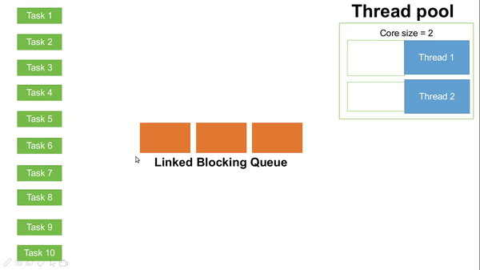
Circuit Breaker

Slide 64
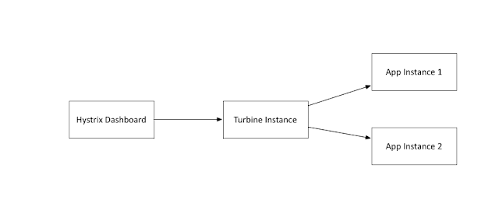
Turbine

Slide 65
Using Blue-Green Deployment to Reduce Downtime and Risk
Blue-green deployment is a technique that reduces downtime and risk by running two identical production environments called Blue and Green.
At any time, only one of the environments is live, with the live environment serving all production traffic. For this example, Blue is currently live and Green is idle.

Slide 66
Using Blue-Green Deployment to Reduce Downtime and Risk
As you prepare a new version of your software, deployment and the final stage of testing takes place in the environment that is not live: in this example, Green.
Once you have deployed and fully tested the software in Green, you switch the router so all incoming requests now go to Green instead of Blue. Green is now live, and Blue is idle.

Slide 67
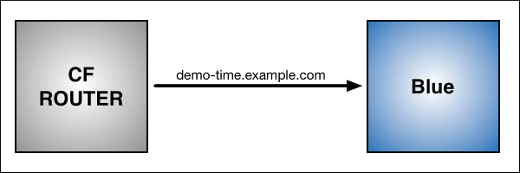
Blue-Green Deployment with Cloud Foundry
$ cf push Blue -n demo-time

Slide 68
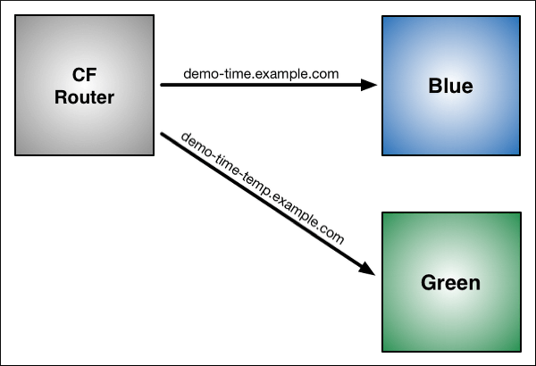
Blue-Green Deployment with Cloud Foundry
$ cf push Green -n demo-time-temp

Slide 69
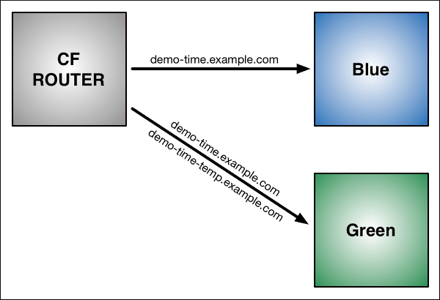
Blue-Green Deployment with Cloud Foundry
$ cf map-route Green example.com -n demo-time
Binding demo-time.example.com to Green... OK

Slide 70
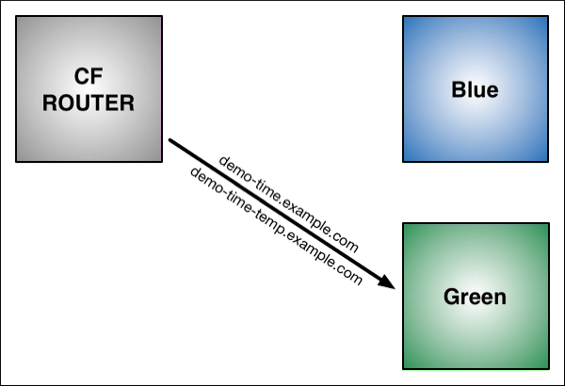
Blue-Green Deployment with Cloud Foundry
$ cf unmap-route Blue example.com -n demo-time
Unbinding demo-time.example.com from blue... OK

Slide 71
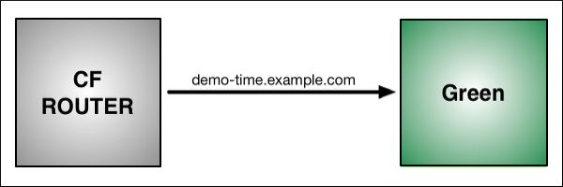
Blue-Green Deployment with Cloud Foundry
cf delete-route

Slide 72
How to Deploy Spring Boot Application to Cloud Foundry Platform
Cloud Foundry is one of the Cloud Providers. It is a PaaS service where we can easily deploy and manage our applications and the Cloud Foundry will take care of the rest of the cloud based offerings like scalability, high availability etc.

Slide 73
What is Cloud Foundry
Cloud Foundry is an open-source platform as a service (PaaS) that provides you with a choice of clouds, developer frameworks, and application services.
It is open source and it is governed by the Cloud Foundry Foundation.
The original Cloud Foundry was developed by VMware and currently it is managed by Pivotal, a joint venture company by GE, EMC and VMware.

Slide 74
What is Cloud Foundry
Now since Cloud Foundry is open source product many popular organizations currently provides this platform separately and below are the list of current certified providers.
Pivotal Cloud Foundry
IBM Bluemix
HPE Helion Stackato 4.0
Atos Canopy
CenturyLink App Fog
GE Predix
Huawei FusionStage
SAP Cloud Platform
Swisscom Application Cloud

Slide 75
Cloud Foundry Installation for Windows
Download the CF Windows installer. It will prompt for the download. Save the zip file distribution.
Unpack the zip file to a suitable place in your workstation.
After successfully unzip operation, double cick on the cf CLI executable.
When prompted, click Install, then Close. Here are the sample steps for the same. This is very straight froward, you can select the default values.

Slide 76
Cloud Foundry Installation for Windows
Verify the installation by opening a terminal window and type cf. If your installation was successful, the cf CLI help listing appears. This indicates that you are ready to go with any cloud foundry platform from your local workstation.

Slide 77
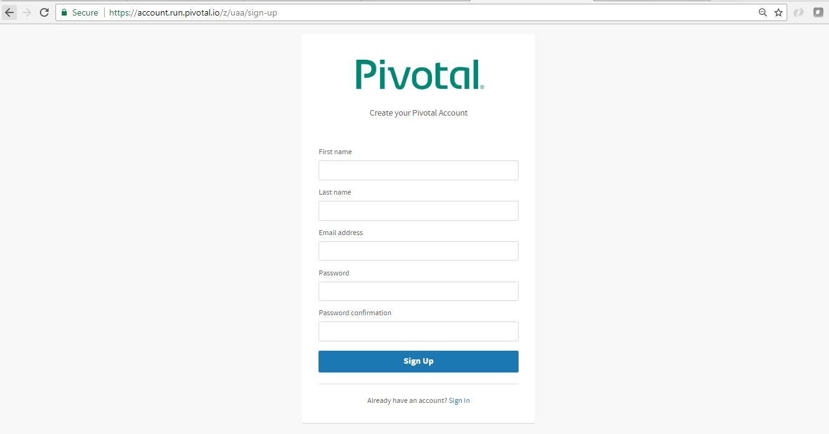
Setup PWS Console

Slide 78
Login and logout from PWS Console using CLI
Login to PWS – We will use cf login -a api.run.pivotal.io command to login to pivotal web service console from CLI tool that we have installed in our local workstation. It will logon the CLI tool to PWS platform so that we can deploy and manage our applications from our workstation. After giving command, it will ask for registered email and password and once provided successfully, it will logon to the platform.
Logout from PWS Console – We will use command cf logout to logout from the platform, once we have all the work done for that session.

Slide 79
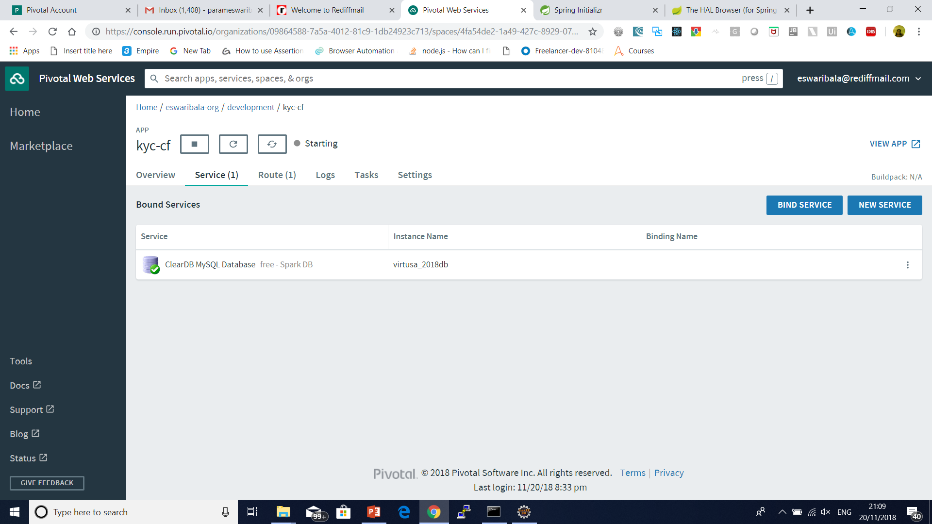
Create Database in cloud foundry

Slide 80
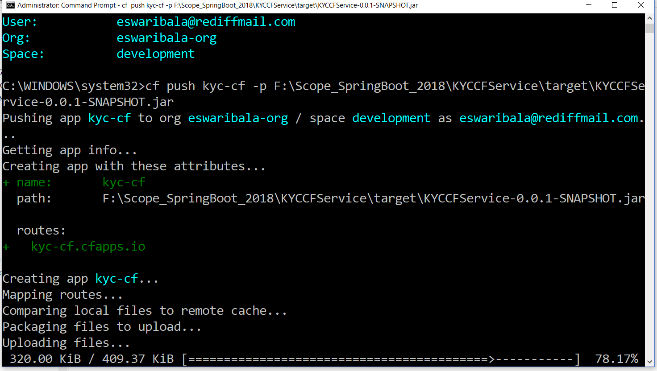
Push Application to Console
cf push kyc-cf -p target\spring-helloworld-cf-0.0.1-SNAPSHOT.jar

Slide 81
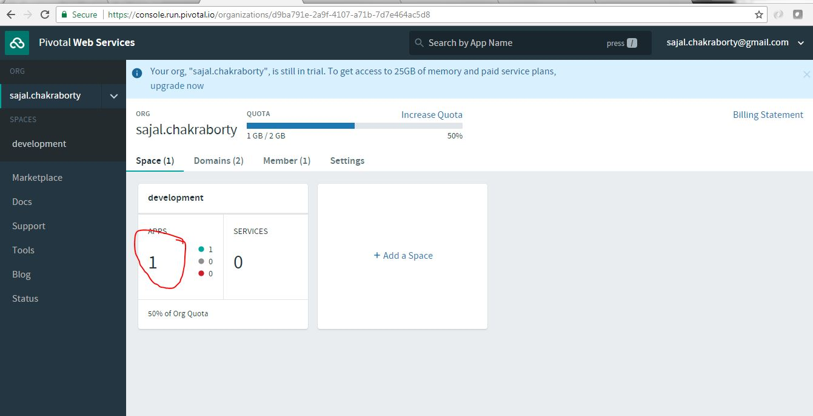
Verify Application Deployed

Slide 82
What is Zuul?
Zuul Server is an API Gateway application.
It handles all the requests and performs the dynamic routing of microservice applications.
It works as a front door for all the requests. It is also known as Edge Server.
Zuul is built to enable dynamic routing, monitoring, resiliency, and security.
It can also route the requests to multiple Amazon Auto Scaling Groups.

Slide 83
What is Zuul?
For Example, /api/products are mapped to the product service and /api/user is mapped to the user service. The Zuul Server dynamically routes the requests to the respective backend application.

Slide 84
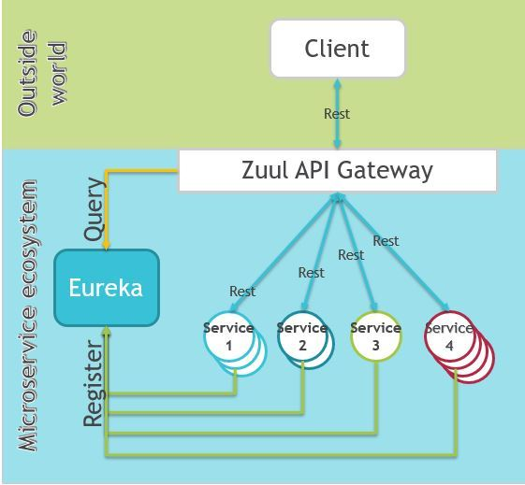
What is Zuul?

Slide 85
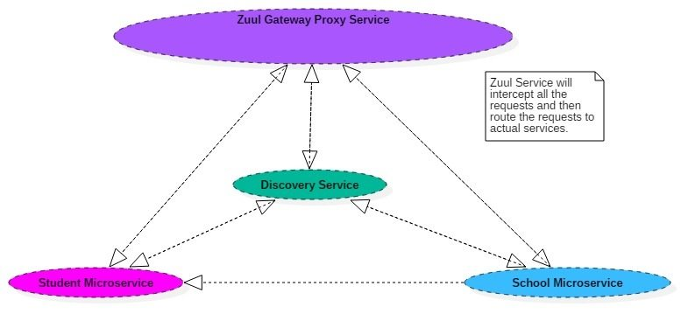
What is Zuul?

Slide 86
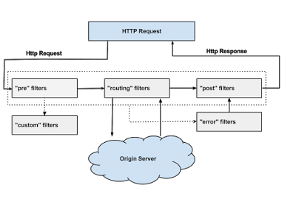

Slide 87
Why did we build Zuul?
The volume and diversity of Netflix API traffic sometimes results in production issues arising quickly and without warning.
We need a system that allows us to rapidly change behaviour in order to react to these situations.

Slide 88
Zuul Components
Zuul has mainly four types of filters that enable us to intercept the traffic in different timeline of the request processing for any particular transaction.
We can add any number of filters for a particular url pattern.
pre filters – are invoked before the request is routed.
post filters – are invoked after the request has been routed.

Slide 89
Zuul Components
route filters – are used to route the request.
error filters – are invoked when an error occurs while handling the request.

Slide 90
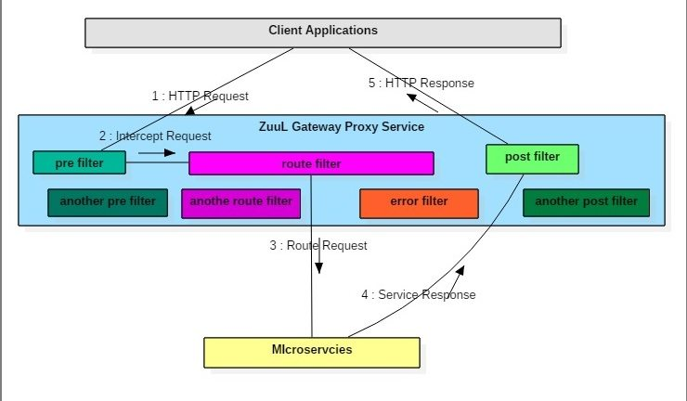
Zuul Components

Slide 91
Zuul Filters Responsibilities
Apply microservice authentication and security in the gateway layer to protect the actual services
We can do microservices insights and monitoring of all the traffic that are going in to the ecosystem by enabling some logging to get meaningful data and statistics at the edge in order to give us an accurate view of production.

Slide 92
Zuul Filters Responsibilities
Dynamic Routing can route requests to different backend clusters as needed.
We can do runtime stress testing by gradually increasing the traffic to a new cluster in order to gauge performance in many scenarios e.g. cluster has new H/W and network setup or that has new version of production code deployed.

Slide 93
Zuul Filters Responsibilities
We can do dynamic load shedding i.e. allocating capacity for each type of request and dropping requests that go over the limit.
We can apply static response handling i.e. building some responses directly at the edge instead of forwarding them to an internal cluster for processing.

Slide 94
Zuul Filters Responsibilities
Authentication and Security — identifying authentication requirements for each resource and rejecting requests that do not satisfy them.
Insights and Monitoring — tracking meaningful data and statistics at the edge in order to give us an accurate view of production.
Dynamic Routing — dynamically routing requests to different backend clusters as needed.
Stress Testing — gradually increasing the traffic to a cluster in order to gauge performance.

Slide 95
Zuul Filters Responsibilities
Load Shedding — allocating capacity for each type of request and dropping requests that go over the limit.
Static Response handling — building some responses directly at the edge instead of forwarding them to an internal cluster
Multiregion Resiliency — routing requests across AWS regions in order to diversify our ELB usage and move our edge closer to our members

Slide 96
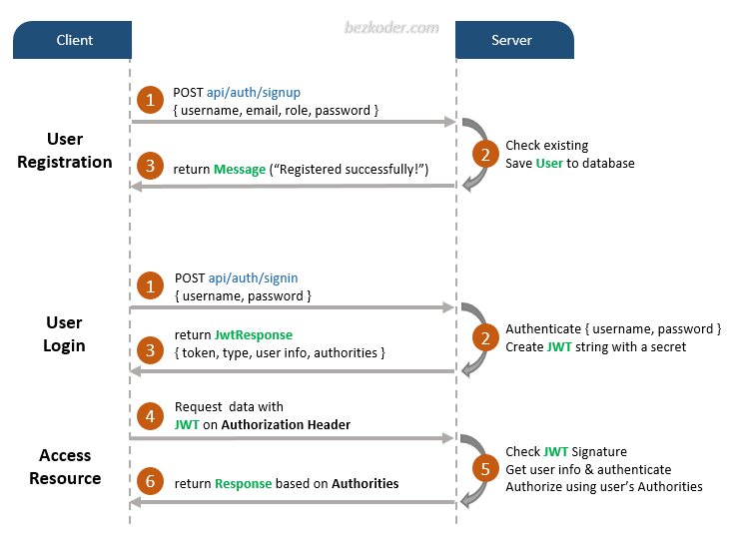
JWT Authentication

Slide 97
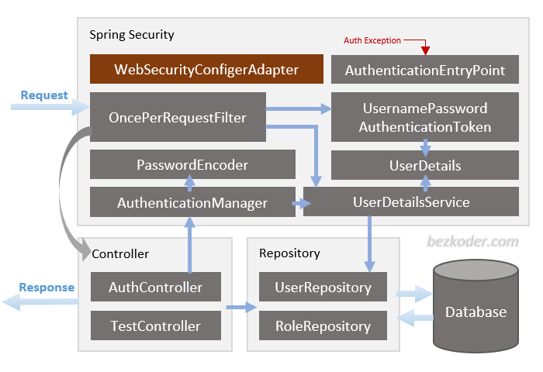
JWT Authentication

Slide 98
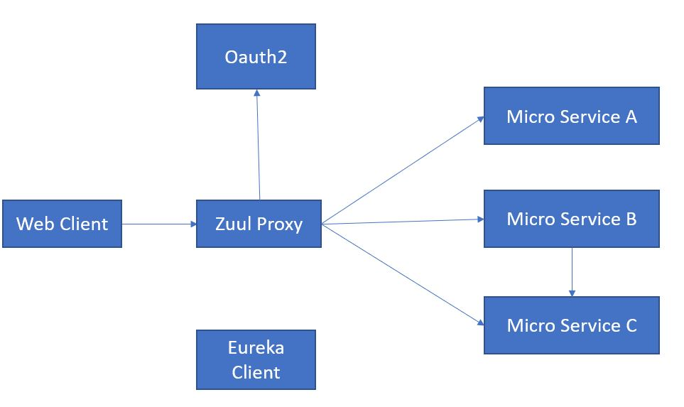
Zuul Authentication and Authorization

Slide 99

Oauth2

Slide 100

Oauth2

Slide 101
What Is Redis?
Redis is an open-source (BSD licensed), in-memory data structure store, used as a database, cache, and message broker.
It supports data structures such as string, hashes, lists, sets, sorted sets with range queries, bitmaps, hyper logs, and geospatial indexes with radius queries.

Slide 102
Why Redis?
Redis is basically used for cache management.
It reduces the client workload and speeds up the application.

Slide 103

Calling an External Application API

Slide 104

Frequently Querying the Reference Table or Master Table in the Database

Slide 105

Spring Cloud Config Server with git

Slide 106

Spring Cloud Config Server with git

Slide 107


Spring Cloud Config Server with git

Slide 108

Micro service With Multiple Port

Slide 109

Micro service With Multiple Port

Slide 110

Micro service With Multiple Port

Slide 111

RIBBON LOAD BALANCER
@RibbonClient(name = "server", configuration = RibbonConfiguration.class)

Slide 112


Slide 113


Slide 114


Slide 115


Slide 116


Slide 117
RIBBON LOAD BALANCER
Ribbon is a client-side load balancer, which gives you a lot of control over the behavior of HTTP and TCP clients.
Ribbon's Client component offers a good set of configuration options such as connection timeouts, retries, retry algorithm (exponential, bounded back off) etc.
Ribbon comes built in with a pluggable and customizable Load Balancing component.

Slide 118
RIBBON LOAD BALANCER
Some of the load balancing strategies offered are listed below:
Simple Round Robin LB
Weighted Response Time LB
Zone Aware Round Robin LB
Random LB

Slide 119
RIBBON LOAD BALANCER
Ribbon provides the following features:
Load balancing
Fault tolerance
Multiple protocols (HTTP, TCP, UDP) support in an asynchronous and reactive model
Caching and batching

Slide 120
RIBBON LOAD BALANCER
Bean Type | Bean Name | Class Name
IClientConfig | ribbonClientConfig | DefaultClientConfigImpl
IRule | ribbonRule | ZoneAvoidanceRule
IPing | ribbonPing | DummyPing
ServerList<Server> | ribbonServerList | ConfigurationBasedServerList
ServerListFilter<Server> | ribbonServerListFilter | ZonePreferenceServerListFilter
ILoadBalancer | ribbonLoadBalancer | ZoneAwareLoadBalancer
ServerListUpdater | ribbonServerListUpdater | PollingServerListUpdater

Slide 121
RIBBON LOAD BALANCER
The properties file (sample-client.properties)
# Max number of retries on the same server (excluding the first try)
sample-client.ribbon.MaxAutoRetries=1
# Max number of next servers to retry (excluding the first server)
sample-client.ribbon.MaxAutoRetriesNextServer=1
# Whether all operations can be retried for this client
sample-client.ribbon.OkToRetryOnAllOperations=true
# Interval to refresh the server list from the source
sample-client.ribbon.ServerListRefreshInterval=2000
#

Slide 122
RIBBON LOAD BALANCER
Connect timeout used by Apache HttpClient
sample-client.ribbon.ConnectTimeout=3000
# Read timeout used by Apache HttpClient
sample-client.ribbon.ReadTimeout=3000
# Initial list of servers, can be changed via Archaius dynamic property at runtime
sample-client.ribbon.listOfServers=www.microsoft.com:80,www.yahoo.com:80,www.google.com:80

Slide 123


Slide 124

Feign Client

Slide 125

API Gateway

Slide 126

Zipkin

Slide 127
Docker
Docker is an excellent tool for managing and deploying microservices.
Each microservice can be further broken down into processes running in separate Docker containers, which can be specified with Dockerfiles and Docker Compose configuration files.
Combined with a provisioning tool such as Kubernetes, each microservice can then be easily deployed, scaled, and collaborated on by a developer team.
Specifying an environment in this way also makes it easy to link microservices together to form a larger application.

Slide 128

Docker

Slide 129


Slide 130
Hypervisor
A hypervisor is a software that makes virtualization possible.
It is also called Virtual Machine Monitor.
It divides the host system and allocates the resources to each divided virtual environment.

Slide 131

Hypervisor

Slide 132
Hypervisor
Hyper-V will only run on processors which support hardware assisted virtualization.
The x86 family of CPUs provide a range of protection levels also known as rings in which code can execute.
Ring 0 has the highest level privilege and it is in this ring that the operating system kernel normally runs.
Code executing in ring 0 is said to be running in system space, kernel mode or supervisor mode.
All other code, such as applications running on the operating system, operate in less privileged rings, typically ring 3.

Slide 133
Hypervisor
Under Hyper-V hypervisor virtualization a program known as a hypervisor runs directly on the hardware of the host system in ring 0.
The task of this hypervisor is to handle tasks such CPU and memory resource allocation for the virtual machines in addition to providing interfaces for higher level administration and monitoring tools.

Slide 134
Hypervisor
If the hypervisor is going to occupy ring 0 of the CPU, the kernels for any guest operating systems running on the system must run in less privileged CPU rings.
Unfortunately, most operating system kernels are written explicitly to run in ring 0 for the simple reason that they need to perform tasks that are only available in that ring, such as the ability to execute privileged CPU instructions and directly manipulate memory.

Slide 135
Hypervisor
One solution to this problem is to modify the guest operating systems, replacing any privileged operations that will only run in ring 0 of the CPU with calls to the hypervisor (known as hypercalls).
The hypervisor in turn performs the task on behalf of the guest system.

Slide 136
Hypervisor
Another solution is to leverage the hardware assisted virtualization features of the latest generation of processors from both Intel and AMD.
These technologies, known as Intel VT and AMD-V respectively, provide extensions necessary to run unmodified guest virtual machines.
These new processors provide an additional privilege mode (referred to as ring -1) above ring 0 in which the hypervisor can operate, essentially leaving ring 0 available for unmodified guest operating systems.

Slide 137

Hyper-V Root and Child Partitions

Slide 138
Hyper-V Root and Child Partitions
The root partition is essentially a virtual machine which runs a copy of 64-bit Windows Server 2008 which, in turn, acts as a host for a number of special Hyper-V components.
The root partition is responsible for providing the device drivers for the virtual machines running in the child partitions, managing the child partition lifecycles, power management and event logging.
The root partition operating system also hosts the Virtualization Stack which is responsible for performing a wide range of virtualization functions.
Child partitions host the virtual machines in which the guest operating systems run. Hyper-V supports both Hyper-V Aware (also referred to as enlightened) and Hyper-V Unaware guest operating systems.

Slide 139

The Virtualization Stack and Other Root Partition Components

Slide 140
The Virtualization Stack and Other Root Partition Components
Component | Description
Virtual Machine Management Service (VMM Service) | Manages the state of virtual machines running in the child partitions (active, offline, stopped etc) and controls the tasks that can be performed on a virtual machine based on current state (such as taking snapshots). Also manages the addition and removal of devices. When a virtual machine is started, the VMM Service is also responsible for creating a corresponding Virtual Machine Worker Process.
Virtual Machine Worker Process | Virtual Machine Worker Processes are started by the VMM Service when virtual machines are started. A Virtual Machine Worker Process (named vmwp.exe) is created for each Hyper-V virtual machine and is responsible for much of the management level interaction between the parent partition Windows Server 2008 system and the virtual machines in the child partitions. The duties of the Virtual Machine Worker Process include creating, configuring, running, pausing, resuming, saving, restoring and snapshotting the associated virtual machine. It also handles IRQs, memory and I/O port mapping through a Virtual Motherboard (VMB).

Slide 141
The Virtualization Stack and Other Root Partition Components
Component | Description
Virtual Devices | Virtual Devices are managed by the Virtual Motherboard (VMB). Virtual Motherboards are contained within the Virtual Machine Worker Processes, of which there is one for each virtual machine. Virtual Devices fall into two categories, Core VDevs and Plug-in VDevs. Core VDevs can either be Emulated Devices or Synthetic Devices.
Virtual Infrastructure Driver | Operates in kernel mode (i.e. in the privileged CPU ring) and provides partition, memory and processor management for the virtual machines running in the child partitions. The Virtual Infrastructure Driver (Vid.sys) also provides the conduit for the components higher up the Virtualization Stack to communicate with the hypervisor.

Slide 142
The Virtualization Stack and Other Root Partition Components
Component | Description
Windows Hypervisor Interface Library | A DLL (named WinHv.sys) located in the parent partition Windows Server 2008 instance and any guest operating systems which are Hyper-V aware (in other words modified specifically to operate in a Hyper-V child partition). Allows the operating system's drivers to access the hypervisor using standard Windows API calls instead of hypercalls.
VMBus | Part of Hyper-V Integration Services, the VMBus facilitates highly optimized communication between child partitions and the parent partition

Slide 143
The Virtualization Stack and Other Root Partition Components
Component | Description
Virtualization Service Providers | Resides in the parent partition and provides synthetic device support via the VMBus to Virtual Service Clients (VSCs) running in child partitions.
Virtualization Service Clients | Virtualization Service Clients are synthetic device instances that reside in child partitions. They communicate with the VSPs in the parent partition over the VMBus to fulfill the child partition's device access requests.

Slide 144

Hyper-V Architecture

Slide 145
Hyper-V Architecture
APIC – Advanced Programmable Interrupt Controller – A device which allows priority levels to be assigned to its interrupt outputs.
Child Partition – Partition that hosts a guest operating system - All access to physical memory and devices by a child partition is provided via the Virtual Machine Bus (VMBus) or the hypervisor.
Hypercall – Interface for communication with the hypervisor - The hypercall interface accommodates access to the optimizations provided by the hypervisor.

Slide 146
Hyper-V Architecture
Hypervisor – A layer of software that sits between the hardware and one or more operating systems. Its primary job is to provide isolated execution environments called partitions. The hypervisor controls and arbitrates access to the underlying hardware.
IC – Integration component – Component that allows child partitions to communication with other partitions and the hypervisor.
I/O stack – Input/output stack
MSR – Memory Service Routine

Slide 147
Hyper-V Architecture
Root Partition – Sometimes called parent partition. Manages machine-level functions such as device drivers, power management, and device hot addition/removal. The root (or parent) partition is the only partition that has direct access to physical memory and devices.
VID – Virtualization Infrastructure Driver – Provides partition management services, virtual processor management services, and memory management services for partitions.

Slide 148
Hyper-V Architecture
VMBus – Channel-based communication mechanism used for inter-partition communication and device enumeration on systems with multiple active virtualized partitions. The VMBus is installed with Hyper-V Integration Services.
VMMS – Virtual Machine Management Service – Responsible for managing the state of all virtual machines in child partitions.
VMWP – Virtual Machine Worker Process – A user mode component of the virtualization stack.
The worker process provides virtual machine management services from the Windows Server 2008 instance in the parent partition to the guest operating systems in the child partitions.
The Virtual Machine Management Service spawns a separate worker process for each running virtual machine.

Slide 149
Hyper-V Architecture
VSC – Virtualization Service Client – A synthetic device instance that resides in a child partition.
VSCs utilize hardware resources that are provided by Virtualization Service Providers (VSPs) in the parent partition.
They communicate with the corresponding VSPs in the parent partition over the VMBus to satisfy a child partitions device I/O requests.
VSP – Virtualization Service Provider – Resides in the root partition and provide synthetic device support to child partitions over the Virtual Machine Bus (VMBus).

Slide 150
Hyper-V Architecture
WinHv – Windows Hypervisor Interface Library - WinHv is essentially a bridge between a partitioned operating system’s drivers and the hypervisor which allows drivers to call the hypervisor using standard Windows calling conventions
WMI – The Virtual Machine Management Service exposes a set of Windows Management Instrumentation (WMI)-based APIs for managing and controlling virtual machines.

Slide 151
hyper-v containers
Windows Hyper-v container is a windows server container that runs in a VM.
Every hyper-v container creates its own VM.
This means that there is no kernel sharing between the different hyper-v containers.
This is useful for cases where additional level of isolation is needed by customers who don’t like the traditional kernel sharing done by containers.
The same Docker image and CLI can be used to manage hyper-v containers.
Creation of hyper-v containers is specified as a runtime option.
There is no difference when building or managing containers between windows server and hyper-v container.
Startup times for hyper-v container is higher than windows native container since a new lightweight VM gets created each time.

Slide 152
hyper-v containers
Creation of hyper-v containers is specified as a runtime option.
There is no difference when building or managing containers between windows server and hyper-v container.
Startup times for hyper-v container is higher than windows native container since a new lightweight VM gets created each time.

Slide 153
hyper-v containers
There are 2 modes of hyper-v container.
Windows hyper-v container – Here, hyper-v container runs on top of Windows kernel. Only Windows containers can be run in this mode.
Linux hyper-v container – Here, hyper-v container runs on top of Linux kernel. This mode was not available earlier and it was introduced as part of Dockercon 2017. Any Linux flavor can be used as the base kernel. Docker’s Linuxkit project can be used to build the Linux kernel needed for the hyper-v container. Only Linux containers can be run in this mode.

Slide 154
hyper-v containers
We cannot use Docker Toolbox and hyper-v containers at the same time. Virtualbox cannot run when “Docker for Windows” is installed.
https://nickjanetakis.com/blog/should-you-use-the-docker-toolbox-or-docker-for-mac-windows

Slide 155

Docker

Slide 156

Docker Architecture

Slide 157

Docker Architecture

Slide 158

Docker Engine

Slide 159
Dockerfile, Docker Image And Docker Container:
A Docker Image is created by the sequence of commands written in a file called as Dockerfile.
When this Dockerfile is executed using a docker command it results into a Docker Image with a name.
When this Image is executed by “docker run” command it will by itself start whatever application or service it must start on its execution.

Slide 160
Image Demo
https://learnk8s.io/spring-boot-kubernetes-guide

Slide 161


Slide 162
Docker Network
Docker implements networking in an application-driven manner and provides various options while maintaining enough abstraction for application developers.
There are basically two types of networks available - the default Docker network and user-defined networks.
By default, you get three different networks on the installation of Docker - none, bridge, and host.

Slide 163
Docker Network
The none and host networks are part of the network stack in Docker.
The bridge network automatically creates a gateway and IP subnet and all containers that belong to this network can talk to each other via IP addressing.
This network is not commonly used as it does not scale well and has constraints in terms of network usability and service discovery.

Slide 164
Docker Network
The other type of networks is user-defined networks. Administrators can configure multiple user-defined networks.
There are three types:
Bridge network: Similar to the default bridge network, a user-defined Bridge network differs in that there is no need for port forwarding for containers within the network to communicate with each other.
The other difference is that it has full support for automatic network discovery.

Slide 165
Docker Network
Overlay network: An Overlay network is used when you need containers on separate hosts to be able to communicate with each other, as in the case of a distributed network.
However, a caveat is that swarm mode must be enabled for a cluster of Docker engines, known as a swarm, to be able to join the same group.
Macvlan network: When using Bridge and Overlay networks a bridge resides between the container and the host.
A Macvlan network removes this bridge, providing the benefit of exposing container resources to external networks without dealing with port forwarding.
This is realized by using MAC addresses instead of IP addresses.

Slide 166
Storage
You can store data within the writable layer of a container but it requires a storage driver.
Being non-persistent, it perishes whenever the container is not running.
It is not easy to transfer this data.
In terms of persistent storage, Docker offers four options:
Data Volume, Data Volume Container, Directory Mounts, Storage Plugins

Slide 167
Storage
There are storage plugins from various companies to automate the storage provisioning process. For example,
HPE 3PAR
EMC (ScaleIO, XtremIO, VMAX, Isilon)
NetApp
There are also plugins that support public cloud providers like:
Azure File Storage
Google Compute Platform.

Slide 168
Registries
A Docker registry is a storage and distribution system for named Docker images.
The same image might have multiple different versions, identified by their tags.
A Docker registry is organized into Docker repositories , where a repository holds all the versions of a specific image.
The registry allows Docker users to pull images locally, as well as push new images to the registry (given adequate access permissions when applicable).

Slide 169
Registries
By default, the Docker engine interacts with DockerHub , Docker's public registry instance.
However, it is possible to run on-premise the open-source Docker registry/distribution, as well as a commercially supported version called Docker Trusted Registry .

Slide 170
Docker Hub
DockerHub is a hosted registry solution by Docker Inc.
Besides public and private repositories, it also provides automated builds, organization accounts, and integration with source control solutions like Github and Bitbucket .

Slide 171
Docker Hub
A public repository is accessible by anyone running Docker, and image names include the organization/user name.
For example, docker pull jenkins/jenkins will pull the Jenkins CI server image with tag latest from the Jenkins organization.
There are hundreds of thousands public images available.
Private repositories restrict access to the repository creator or members of its organization.

Slide 172
Docker Hub
DockerHub supports official repositories, which include images verified for security and best practices.
These do not require an organization/user name, for example docker pull nginx will pull the latest image of the Nginx load balancer.
DockerHub can perform automated image builds if the DockerHub repository is linked to a source control repository which contains a build context (Dockerfile and all any files in the same folder).
A commit in the source repository will trigger a build in DockerHub.

Slide 173
Other Public Registries
Other companies host paid online Docker registries for public use.
Cloud providers like AWS and Google, who also offer container-hosting services, market the high availability of their registries.

Slide 174
Other Public Registries
Amazon Elastic Container Registry (ECR) integrates with AWS Identity and Access Management (IAM) service for authentication. It supports only private repositories and does not provide automated image building.
Google Container Registry (GCR) authentication is based on Google’s Cloud Storage service permissions. It supports only private repositories and provides automated image builds via integration with Google Cloud Source Repositories, GitHub, and Bitbucket.

Slide 175
Other Public Registries
Azure Container Registry (ACR) supports multi-region registries and authenticates with Active Directory. It supports only private repositories and does not provide automated image building.
CoreOS Quay supports OAuth and LDAP authentication. It offers both (paid) private and (free) public repositories, automatic security scanning and automated image builds via integration with GitLab, GitHub, and Bitbucket.
Private Docker Registry supports OAuth, LDAP and Active Directory authentication. It offers both private and public repositories, free up to 3 repositories (private or public).

Slide 176
Private Registries
Use cases for running a private registry on-premise (internal to the organization) include:
Distributing images inside an isolated network (not sending images over the Internet)
Creating faster CI/CD pipelines (pulling and pushing images from internal network), including faster deployments to on-premise environments
Deploying a new image over a large cluster of machines
Tightly controlling where images are being stored

Slide 177
Private Registries
Running a private registry system, especially when delivery to production depends on it, requires operational skills such as ensuring availability, logging and log processing, monitoring, and security.
Strong understanding of http and overall network communications is also important.

Slide 178
Private Registries
Docker Trusted Registry is Docker Inc’s commercially supported version, providing high availability via replication, image auditing, signing and security scanning, integration with LDAP and Active Directory.
Harbor is a VMWare open source offering which also provides high availability via replication, image auditing, integration with LDAP and Active Directory.
GitLab Container Registry is tightly integrated with GitLab CI’s workflow, with minimal setup.
JFrog Artifactory for strong artifact management (not only Docker images but any artifact).

Slide 179

Should You Install Docker with the Docker Toolbox or Docker for Mac / Windows?

Slide 180
Should You Install Docker with the Docker Toolbox or Docker for Mac / Windows?
If you’re on MacOS or Windows you can install Docker with:
Docker for Mac / Windows (now known as Docker Desktop)
Docker Toolbox
Running your own Virtual Machine and installing Docker yourself

Slide 181
Should You Install Docker with the Docker Toolbox or Docker for Mac / Windows?
If you’re on MacOS or Windows you can install Docker with:
Docker for Mac / Windows (now known as Docker Desktop)
Docker Toolbox
Running your own Virtual Machine and installing Docker yourself

Slide 182
Docker for Mac / Docker for Windows (Docker Desktop)
Pros
Offers the most “native” experience, you can easily use any terminal you you want since Docker is effectively running on localhost from MacOS / Windows’ POV.
Docker is heavily developing and polishing this solution.

Slide 183
Docker for Mac / Docker for Windows (Docker Desktop)
Cons
On certain MacOS hardware combos the volume performance can be a little slow.
I can legit say there are not any “wow this sucks!” cons for Windows, it’s really solid.

Slide 184
Docker Toolbox
Pros
Offers an “out of the box” Docker experience if you have no other choice.

Slide 185
Docker Toolbox
Cons
You need to either use the Docker Quickstart Terminal, or configure your own terminal to connect to the Docker Daemon running a VM.
Not a native solution, so you’ll need to access your Docker Machine’s IP address if you’re developing web apps. Example: 192.168.99.100 instead of localhost.

Slide 186
Docker Toolbox
Cons
Unless you jump through hoops, your code needs to live in your Windows user directory such as C:\Users\eswari\src\myapp. Otherwise Docker won’t be able to find it.
Suffers from typical VirtualBox edge case bugs and mount performance issues.

Slide 187
What is Docker
What is Docker?
At its heart, Docker is software which lets you create an image and then run instances of that image in a container.
Docker maintain a vast repository of images, called the Docker Hub which you can use as starting points or as free storage for your own images.
You can install Docker, choose an image you'd like to use, then run an instance of it in a container.

Slide 188
Difference between VM and Container
Applications running in virtual machines, apart from the hypervisor, require a full instance of the operating system and any supporting libraries.
Containers, on the other hand, share the operating system with the host.
Hypervisor is comparable to the container engine (represented as Docker on the image) in a sense that it manages the lifecycle of the containers.
The important difference is that the processes running inside the containers are just like the native processes on the host, and do not introduce any overheads associated with hypervisor execution.
Additionally, applications can reuse the libraries and share the data between containers.

Slide 189


Slide 190


Slide 191
Docker Hub:
Docker Hub is like GitHub for Docker Images. It is basically a cloud registry where you can find Docker Images uploaded by different communities, also you can develop your own image and upload on Docker Hub, but first, you need to create an account on DockerHub.

Slide 192

Docker Hub

Slide 193
Docker Architecture
It consists of a Docker Engine which is a client-server application with three major components:
A server which is a type of long-running program called a daemon process (the docker command).
A REST API which specifies interfaces that programs can use to talk to the daemon and instruct it what to do.
A command line interface (CLI) client (the docker command).
The CLI uses the Docker REST API to control or interact with the Docker daemon through scripting or direct CLI commands. Many other Docker applications use the underlying API and CLI.

Slide 194
Docker Architecture
By default, the main registry is the Docker Hub which hosts public and official images.
Organizations can also host their private registries if they desire.
Images can be downloaded from registries explicitly (docker pull imageName) or implicitly when starting a container. Once the image is downloaded it is cached locally.
Containers are the instances of images - they are the living thing. There could be multiple containers running based on the same image.

Slide 195
Docker Architecture
At the center, there is the Docker daemon responsible for creating, running, and monitoring containers.
It also takes care of building and storing images.
Finally, on the left-hand side there is a Docker client. It talks to the daemon via HTTP.
Unix sockets are used when on the same machine, but remote management is possible via HTTP based API.

Slide 196

Goals of Docker Networking

Slide 197
Creating Test Database Server
This is a great Docker use case.
We might not want to run our production database in Docker (perhaps we'll just use Amazon RDS for example), but we can spin up a clean MySQL database in no time as a Docker container for development - leaving our development machine clean and keeping everything we do controlled and repeatable.

Slide 198
Docker Compose
Docker Compose is basically used to run multiple Docker Containers as a single server. Let me give you an example:
Suppose if I have an application which requires WordPress, Maria DB and PHP MyAdmin. I can create one file which would start both the containers as a service without the need to start each one separately. It is really useful especially if you have a microservice architecture.

Slide 199
Docker Container
Column | Description
Container ID | The unique ID of the container. It is a SHA-256.
Image | The name of the container image from which this container is instantiated.
Status | The status of the container (created, restarting, running, removing, paused, exited, or dead).
Ports | The list of container ports that have been mapped to the host.
Names | The name assigned to this container (multiple names are possible).

Slide 200
Docker Client and Docker Engine
Docker Client : This is the utility we use when we run any docker commands e.g. docker run (docker container run) , docker images , docker ps etc. It allows us to run these commands which a human can easily understand.
Docker Daemon/Engine: This is the part which does rest of the magic and knows how to talk to the kernel, makes the system calls to create, operate and manage containers, which we as users of docker dont have to worry about.

Slide 201
Creating Test Database Server
docker run --name olddb -e MYSQL_ROOT_PASSWORD=vignesh –e MYSQL_DATABASE=virtusa_2018db –e MYSQL_USER=root -p 3306:3306 mysql/mysql-server:5.5
docker run tells the engine we want to run an image (the image comes at the end, mysql:vlatest
--name db names this container db.
-d detach - i.e. run the container in the background.
-e MYSQL_ROOT_PASSWORD=123 the -e is the flag that tells docker we want to provide an environment variable. The variable following it is what the MySQL image checks for setting the default root password.
-p 3306:3306 tells the engine that we want to map the port 3306 from inside the container to out port 3306.

Slide 202


Slide 203

Creating Test Database Server
Docker ps
docker exec -it olddb /bin/bash
mysql –u root –p

Slide 204
Springboot Docker
<plugin>
<groupId>com.spotify</groupId>
<artifactId>docker-maven-plugin</artifactId>
<version>VERSION GOES HERE</version>
<configuration>
<imageName>example</imageName>
<baseImage>java</baseImage>
<entryPoint>["java", "-jar", "/${project.build.finalName}.jar"]</entryPoint>
<!-- copy the service's jar file from target into the root directory of the image -->
<resources>
<resource>
<targetPath>/</targetPath>
<directory>${project.build.directory}</directory>
<include>${project.build.finalName}.jar</include>
</resource>
</resources>
</configuration>
</plugin>

Slide 205
Best practices for writing Dockerfiles
Docker builds images automatically by reading the instructions from a Dockerfile -- a text file that contains all commands, in order, needed to build a given image.
A Dockerfile adheres to a specific format and set of instructions which you can find at Dockerfile reference.
A Docker image consists of read-only layers each of which represents a Dockerfile instruction.
The layers are stacked and each one is a delta of the changes from the previous layer.

Slide 206
Command | Purpose
FROM | To specify the parent image.
WORKDIR | To set the working directory for any commands that follow in the Dockerfile.
RUN | To install any applications and packages required for your container.
COPY | To copy over files or directories from a specific location.
ADD | As COPY, but also able to handle remote URLs and unpack compressed files.
ENTRYPOINT | Command that will always be executed when the container starts. If not specified, the default is /bin/sh -c
CMD | Arguments passed to the entrypoint. If ENTRYPOINT is not set (defaults to /bin/sh -c), the CMD will be the commands the container executes.
EXPOSE | To define which port through which to access your container application.
LABEL | To add metadata to the image.

Slide 207
Best practices for writing Dockerfiles
FROM ubuntu:18.04
COPY . /app
RUN make /app
CMD python /app/app.py
FROM creates a layer from the ubuntu:18.04 Docker image.
COPY adds files from your Docker client’s current directory.
RUN builds your application with make.
CMD specifies what command to run within the container.

Slide 208
Best practices for writing Dockerfiles
https://docs.docker.com/develop/develop-images/dockerfile_best-practices/

Slide 209
Springboot Docker
Spring boot Project Build
Goal package docker:build
mvn clean install dockerfile:build
Docker folder created and docker image name example deployed in docker machine
Check docker images
Docker ps

Slide 210
Springboot Docker
Docker run –t –name sampleapp –link v1db –p 8080:8080 example:latest
Example:latest --- image name
--name – container reference
--link – db ref in container
docker run -h 192.168.99.100 -p 7070:7070 -t my-repo/example --name my-repo-image:latest

Slide 211
Docker Volume
Volumes are the preferred mechanism for persisting data generated by and used by Docker containers.
While bind mounts are dependent on the directory structure of the host machine, volumes are completely managed by Docker.

Slide 212
Docker Volume
Volumes have several advantages over bind mounts:
Volumes are easier to back up or migrate than bind mounts.
You can manage volumes using Docker CLI commands or the Docker API.
Volumes work on both Linux and Windows containers.
Volumes can be more safely shared among multiple containers.
Volume drivers let you store volumes on remote hosts or cloud providers, to encrypt the contents of volumes, or to add other functionality.
New volumes can have their content pre-populated by a container

Slide 213


Slide 214
Manage Data in Docker
There are 2 ways in which you can manage data in Docker:
Data volumes
Data volume containers

Slide 215
Manage Data in Docker
A data volume is a specially designed directory in the container.
It is initialized when the container is created.
By default, it is not deleted when the container is stopped.
It is not even garbage collected when there is no container referencing the volume.
The data volumes are independently updated.
Data volumes can be shared across containers too. They could be mounted in read-only mode too.

Slide 216
Manage Data in Docker
Mounting a Data volume
docker container run -it -v/udata --tty ubuntu /bin/bash
cd udata
touch file1.txt
exit
docker container restart 2eec01eb7368
docker attach 2eec01eb7368exit
docker container rm 2eec01eb7368
docker volume ls

Slide 217
Manage Data in Docker
After removing container also the data volume is still present on the host.
This is a dangling or ghost volume and could remain there on your machine consuming space.
Do remember to clean up if you want.
Alternatively, there is also a -v option while removing the container

Slide 218


Slide 219


Slide 220


Slide 221


Slide 222
Manage Data in Docker
The sequence of steps are as follows:
We restarted the container (container1)
We attached to the running container (container1)
We did a ls and found that our volume /data is still there.
We did a cd into the /data volume and did a ls there. And our file is still present.

Slide 223

Mounting a Host Directory as a Data volume
docker container run -it -v e:/DockerFileShare/project/web01:/mnt/test ubuntu /bin/bash

Slide 224
Data volume containers
Creating a Data volume container is very useful if you want to share data between containers or you want to use the data from non-persistent containers.
The process is really two step:
You first create a Data volume container
Create another container and mount the volume from the container created in Step 1.

Slide 225
Data volume containers
Creating a Data volume container is very useful if you want to share data between containers or you want to use the data from non-persistent containers.
The process is really two step:
You first create a Data volume container
Create another container and mount the volume from the container created in Step 1.

Slide 226

Data volume containers

Slide 227

Data volume containers

Slide 228

Docker network

Slide 229
Docker network
docker network inspect bridge
Docker automatically creates a subnet and gateway for the bridge network, and docker run automatically adds containers to it. I
If you have containers running on your network, docker network inspect displays networking information for your containers.

Slide 230
Docker network
Any containers on the same network may communicate with one another via IP addresses.
Docker does not support automatic service discovery on bridge.
You must connect containers with the --link option in your docker run command.

Slide 231
Docker network
The Docker bridge supports port mappings and docker run --link allowing communications between containers on the docker0 network.
However, these error-prone techniques require unnecessary complexity.
It’s better to define your own networks instead.

Slide 232
Docker network
None
This offers a container-specific network stack that lacks a network interface.
This container only has a local loopback interface (i.e., no external network interface).

Slide 233
Docker network
Host
This enables a container to attach to your host’s network (meaning the configuration inside the container matches the configuration outside the container).

Slide 234
Defining your own networks
You can create multiple networks with Docker and add containers to one or more networks.
Containers can communicate within networks but not across networks.
A container with attachments to multiple networks can connect with all of the containers on all of those networks.
This lets you build a “hub” of sorts to connect to multiple networks and separate concerns.

Slide 235
Defining your own networks
Bridge networks (similar to the default docker0 network) offer the easiest solution to creating your own Docker network.
While similar, you do not simply clone the default0 network, so you get some new features and lose some old ones.
Follow along below to create your own my_isolated_bridge_network and run your Postgres container my_mysql_db on that network:

Slide 236
Defining your own networks
docker network create --driver bridge my_isolated_bridge_network
docker network inspect my_isolated_bridge_network
docker network ls
docker run --net=my_isolated_bridge_network --name=my_psql_db postgres
docker run --network=my_isolated_bridge_network --name=my_app hello-world

Slide 237

Defining your own networks

Slide 238
Creating an overlay network
If you want native multi-host networking, you need to create an overlay network.
These networks require a valid key-value store service, such as Consul, Etcd, or ZooKeeper.
You must install and configure your key-value store service before creating your network.
Your Docker hosts (you can use multiple hosts with overlay networks) must communicate with the service you choose.
Each host needs to run Docker.
You can provision the hosts with Docker Machine.

Slide 239
Creating an overlay network
Create the overlay network in a similar manner to the bridge network (network name my_multi_host_network):
docker network create --driver overlay my_multi_host_network
Launch containers on each host; make sure you specify the network name:
docker run -itd -net=my_multi_host_network my_python_app

Slide 240
Getting Started with Artifactory as a Docker Registry
Login to your repository use the following command with your Artifactory Cloud credentials.
docker login ${server-name}-{repo-name}.jfrog.io
Pull an image using the following command.
docker pull ${server-name}-{repo-name}.jfrog.io/<image name>
Push an image by first tagging it and then using the push command.
docker tag <image name> ${server-name}-{repo-name}.jfrog.io/<image name>
docker push ${server-name}-{repo-name}.jfrog.io/<image name>

Slide 241
Getting Started with Artifactory as a Docker Registry
In this example, the Artifactory Cloud server is named acme.
Start by creating a virtual Docker repository called dockerv2-virtual.
Pull the hello-world image
docker pull hello-world
Login to repository dockerv2-virtual
docker login acme-dockerv2-virtual.jfrog.io
Tag the hello-world image
docker tag hello-world acme-dockerv2-virtual.jfrog.io/hello-world
Push the tagged hello-world image to dockerv2-virtual
docker push acme-dockerv2-virtual.jfrog.io/hello-world

Slide 242


Slide 243
Docker Swarm
Docker Swarm is Docker’s native feature to support clustering of Docker machines.
This enables multiple machines running Docker Engine to participate in a cluster, called Swarm.
The Docker engines contributing to a Swarm are said to be running in Swarm mode.
Machines enter into the Swarm mode by either initializing a new swarm or by joining an existing swarm.
To the end user the swarm would seem like a single machine.
A Docker engine participating in a swarm is called a node

Slide 244
Docker Swarm
. A node can either be a manager node or a worker node.
The manager node performs cluster management and orchestration while the worker nodes perform tasks allocated by the manager.
A manager node itself, unless configured otherwise, is also be a worker node.
The central entity in the Docker Swarm infrastructure is called a service.
A Docker swarm executes services. The user submits a service to the manager node to deploy and execute.
A service is made up of many tasks. A task is the most basic work unit in a Swarm.
A task is allocated to each worker node b the manager node.

Slide 245
Docker Swarm
The Docker ecosystem consists of tools from development to production deployment frameworks.
In that list, docker swarm fits into cluster management.
A mix of docker-compose, swarm, overlay network and a good service discovery tool such as etcd or consul can be used for managing a cluster of Docker containers.
Docker swarm is still maturing in terms of functionalities when compared to other open-source container cluster management tools.
Considering the vast docker contributors, it won’t be so long for docker swarm to have all the best functionalities other tools possess.
Docker has documented a good production plan for using docker swarm in production.

Slide 246


Slide 247


Slide 248


Slide 249


Slide 250


Slide 251


Docker Swarm Steps

Slide 252


Slide 253
What is Kubernetes?
Kubernetes is a portable, extensible, open-source platform for managing containerized workloads and services, that facilitates both declarative configuration and automation.
It has a large, rapidly growing ecosystem. Kubernetes services, support, and tools are widely available.
The name Kubernetes originates from Greek, meaning helmsman or pilot.
Google open-sourced the Kubernetes project in 2014.
Kubernetes combines over 15 years of Google's experience running production workloads at scale with best-of-breed ideas and practices from the community.

Slide 254
What Is Kubernetes? An Introduction To Container Orchestration Tool
What Is Kubernetes?
Kubernetes is an open-source container management (orchestration) tool. It’s container management responsibilities include container deployment, scaling & descaling of containers & container load balancing.
Download from
https://github.com/kubernetes/minikube
Under curl - windows
https://kubernetes.io/docs/tasks/tools/install-kubectl/#install-kubectl

Slide 255

What is Kubernetes

Slide 256
What Is Kubernetes? An Introduction To Container Orchestration Tool
Why Use Kubernetes?
Companies out there maybe using Docker or Rocket or maybe simply Linux containers for containerizing their applications. But, whatever it is, they use it on a massive scale. They don’t stop at using 1 or 2 containers in Prod. But rather, 10’s or 100’s of containers for load balancing the traffic and ensuring high availability.
.

Slide 257
Why use Kubernetes?
Kubernetes can run on-premises bare metal, OpenStack, public clouds Google, Azure, AWS, etc.
Helps you to avoid vendor lock issues as it can use any vendor-specific APIs or services except where Kubernetes provides an abstraction, e.g., load balancer and storage.
Containerization using kubernetes allows package software to serve these goals. It will enable applications that need to be released and updated without any downtime.
Kubernetes allows you to assure those containerized applications run where and when you want and helps you to find resources and tools which you want to work.

Slide 258
What task are performed by Kubernetes?
Kubernetes is the Linux kernel which is used for distributed systems.
It helps you to be abstract the underlying hardware of the nodes(servers) and offers a consistent interface for applications that consume the shared pool of resources.

Slide 259

What is the need for Container Orchestration?

Slide 260
Kubernetes vs Docker Swarm
Features | Kubernetes | Docker Swarm
Installation & Cluster Config | Setup is very complicated, but once installed cluster is robust. | Installation is very simple, but the cluster is not robust.
GUI | GUI is the Kubernetes Dashboard. | There is no GUI.
Scalability | Highly scalable and scales fast. | Highly scalable and scales 5x faster than Kubernetes.
Auto-scaling | Kubernetes can do auto-scaling. | Docker swarm cannot do auto-scaling.
Load Balancing | Manual intervention needed for load balancing traffic between different containers and pods. | Docker swarm does auto load balancing of traffic between containers in the cluster.
Rolling Updates & Rollbacks | Can deploy rolling updates and does automatic rollbacks. | Can deploy rolling updates, but not automatic rollback.
DATA Volumes | Can share storage volumes only with the other containers in the same pod. | Can share storage volumes with any other container.
Logging & Monitoring | In-built tools for logging and monitoring. | 3rd party tools like ELK stack should be used for logging and monitoring.

Slide 261

What are the features of Kubernetes?

Slide 262
Features of Kubernetes
Automated Scheduling
Self-Healing Capabilities
Automated rollouts & rollback
Horizontal Scaling & Load Balancing
Offers environment consistency for development, testing, and production
Infrastructure is loosely coupled to each component can act as a separate unit
Provides a higher density of resource utilization
Offers enterprise-ready features
Application-centric management
Auto-scalable infrastructure
You can create predictable infrastructure

Slide 263
Kubernetes Basics
Cluster:
It is a collection of hosts(servers) that helps you to aggregate their available resources. That includes ram, CPU, ram, disk, and their devices into a usable pool.
Master:
The master is a collection of components which make up the control panel of Kubernetes. These components are used for all cluster decisions. It includes both scheduling and responding to cluster events.

Slide 264
Kubernetes Basics
Node:
It is a single host which is capable of running on a physical or virtual machine. A node should run both kube-proxy, minikube, and kubelet which are considered as a part of the cluster.
Namespace:
It is a logical cluster or environment. It is a widely used method which is used for scoping access or dividing a cluster.

Slide 265
Kubernetes Architecture and Components
Kubernetes has a decentralized architecture that does not handle tasks sequentially.
It functions based on a declarative model and implements the concept of a ‘desired state.’

Slide 266


Slide 267

Kubernetes architecture

Slide 268
Kubernetes Architecture and Components
These steps illustrate the basic Kubernetes process:
An administrator creates and places the desired state of an application into a manifest file.
The file is provided to the Kubernetes API Server using a CLI or UI.
Kubernetes’ default command-line tool is called kubectl.
Kubernetes stores the file (an application’s desired state) in a database called the Key-Value Store (etcd).
Kubernetes then implements the desired state on all the relevant applications within the cluster.
Kubernetes continuously monitors the elements of the cluster to make sure the current state of the application does not vary from the desired state.

Slide 269

Kubernetes Architecture and Components

Slide 270

Kubernetes Architecture and Components

Slide 271

What is Master Node in Kubernetes Architecture?

Slide 272
API Server
The API Server is the front-end of the control plane and the only component in the control plane that we interact with directly.
Internal system components, as well as external user components, all communicate via the same API.

Slide 273
Key-Value Store (etcd)
The Key-Value Store, also called etcd, is a database Kubernetes uses to back-up all cluster data.
It stores the entire configuration and state of the cluster.
The Master node queries etcd to retrieve parameters for the state of the nodes, pods, and containers.

Slide 274
Controller
The role of the Controller is to obtain the desired state from the API Server.
It checks the current state of the nodes it is tasked to control, and determines if there are any differences, and resolves them, if any.

Slide 275
Scheduler
A Scheduler watches for new requests coming from the API Server and assigns them to healthy nodes.
It ranks the quality of the nodes and deploys pods to the best-suited node.
If there are no suitable nodes, the pods are put in a pending state until such a node appears.

Slide 276

What is Worker Node in Kubernetes Architecture

Slide 277
Kubelet
The kubelet runs on every worker node in the cluster.
It is the principal Kubernetes agent.
By installing kubelet, the node’s CPU, RAM, and storage become part of the broader cluster.
It watches for tasks sent from the API Server, executes the task, and reports back to the Master.
It also monitors pods and reports back to the control panel if a pod is not fully functional.
Based on that information, the Master can then decide how to allocate tasks and resources to reach the desired state.

Slide 278
Container Runtime
The container runtime pulls images from a container image registry and starts and stops containers.
A 3rd party software or plugin, such as Docker, usually performs this function.

Slide 279
Kube-proxy
The kube-proxy makes sure that each node gets its IP address, implements local iptables and rules to handle routing and traffic load-balancing.

Slide 280
Pod
A pod is the smallest element of scheduling in Kubernetes. Without it, a container cannot be part of a cluster. If you need to scale your app, you can only do so by adding or removing pods.
The pod serves as a ‘wrapper’ for a single container with the application code. Based on the availability of resources, the Master schedules the pod on a specific node and coordinates with the container runtime to launch the container

Slide 281

Pod

Slide 282
Pod
In instances where pods unexpectedly fail to perform their tasks, Kubernetes does not attempt to fix them.
Instead, it creates and starts a new pod in its place.
This new pod is a replica, except for the DNS and IP address.
This feature has had a profound impact on how developers design applications.
Due to the flexible nature of Kubernetes architecture, applications no longer need to be tied to a particular instance of a pod.
Instead, applications need to be designed so that an entirely new pod, created anywhere within the cluster, can seamlessly take its place. To assist with this process, Kubernetes uses services

Slide 283


Slide 284
Single Pod with multiple containers
apiVersion: v1
kind: Pod
metadata:
name: mc1
spec:
volumes:
- name: html
emptyDir: {}
containers:
- name: 1st
image: nginx

Slide 285
Single Pod with multiple containers
volumeMounts:
- name: html
mountPath: /usr/share/nginx/html
- name: 2nd
image: debian
volumeMounts:
- name: html
mountPath: /html
command: ["/bin/sh", "-c"]
args:
- while true; do
date >> /html/index.html;
sleep 1;
done

Slide 286
States of a Pod
Through its lifecycle, a Pod can attain following states:
Pending: The pod is accepted by the Kubernetes system but its container(s) is/are not created yet.
Running: The pod is scheduled on a node and all its containers are created and at-least one container is in Running state.
Succeeded: All container(s) in the Pod have exited with status 0 and will not be restarted.
Failed: All container(s) of the Pod have exited and at least one container has returned a non-zero status.
CrashLoopBackoff: The container fails to start and is tried again and again.

Slide 287

Birth of a Pod

Slide 288

Pod Termination

Slide 289
Kubernetes Services
Pods are not constant. One of the best features Kubernetes offers is that non-functioning pods get replaced by new ones automatically.
However, these new pods have a different set of IPs. It can lead to processing issues, and IP churn as the IPs no longer match. If left unattended, this property would make pods highly unreliable.
Services are introduced to provide reliable networking by bringing stable IP addresses and DNS names to the unstable world of pods.
By controlling traffic coming and going to the pod, a Kubernetes service provides a stable networking endpoint – a fixed IP, DNS, and port.
Through a service, any pod can be added or removed without the fear that basic network information would change in any way.

Slide 290
How Do Kubernetes Services Work?
Pods are associated with services through key-value pairs called labels and selectors.
A service automatically discovers a new pod with labels that match the selector.
This process seamlessly adds new pods to the service, and at the same time, removes terminated pods from the cluster.
For example, if the desired state includes three replicas of a pod and a node running one replica fails, the current state is reduced to two pods.
Kubernetes observers that the desired state is three pods.
It then schedules one new replica to take the place of the failed pod and assigns it to another node in the cluster.

Slide 291
How Do Kubernetes Services Work?
The same would apply when updating or scaling the application by adding or removing pods.
Once we update the desired state, Kubernetes notices the discrepancy and adds or removes pods to match the manifest file.
The Kubernetes control panel records, implements, and runs background reconciliation loops that continuously check to see if the environment matches user-defined requirements.

Slide 292

What is Container Deployment?
Traditional Deployment

Slide 293

What is Container Deployment?
virtualized Deployment

Slide 294

What is Container Deployment?
ContainerDeployment

Slide 295

Docker and Kubernetes - Python

Slide 296


Docker and Kubernetes - Python
docker run -p 5000:8087 k8flask:latest

Slide 297

Docker and Kubernetes - Python
docker tag k8flask:latest eswaribala/ecommercecgirepo:p1
Docker push eswaribala/ecommercecgirepo:p1

Slide 298

Deployment file

Slide 299

Deployment file

Slide 300

Deployment file

